Slide 1
Multilingual Poetry Workshop
June 2020

Slide 2




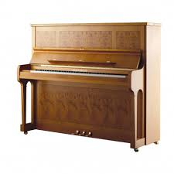

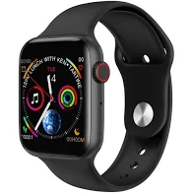
Write a love declaration to it
(in whatever language comes easy)
Choose an item you think you cannot live without
Notes:
Dear Piano,
you are the soundtrack of my life, you are my confidant: I key in my soft side or I bang out my problems!
You are my church: when I sit by you and you resonate in me with sound, I feel as if touched by God!

Slide 3
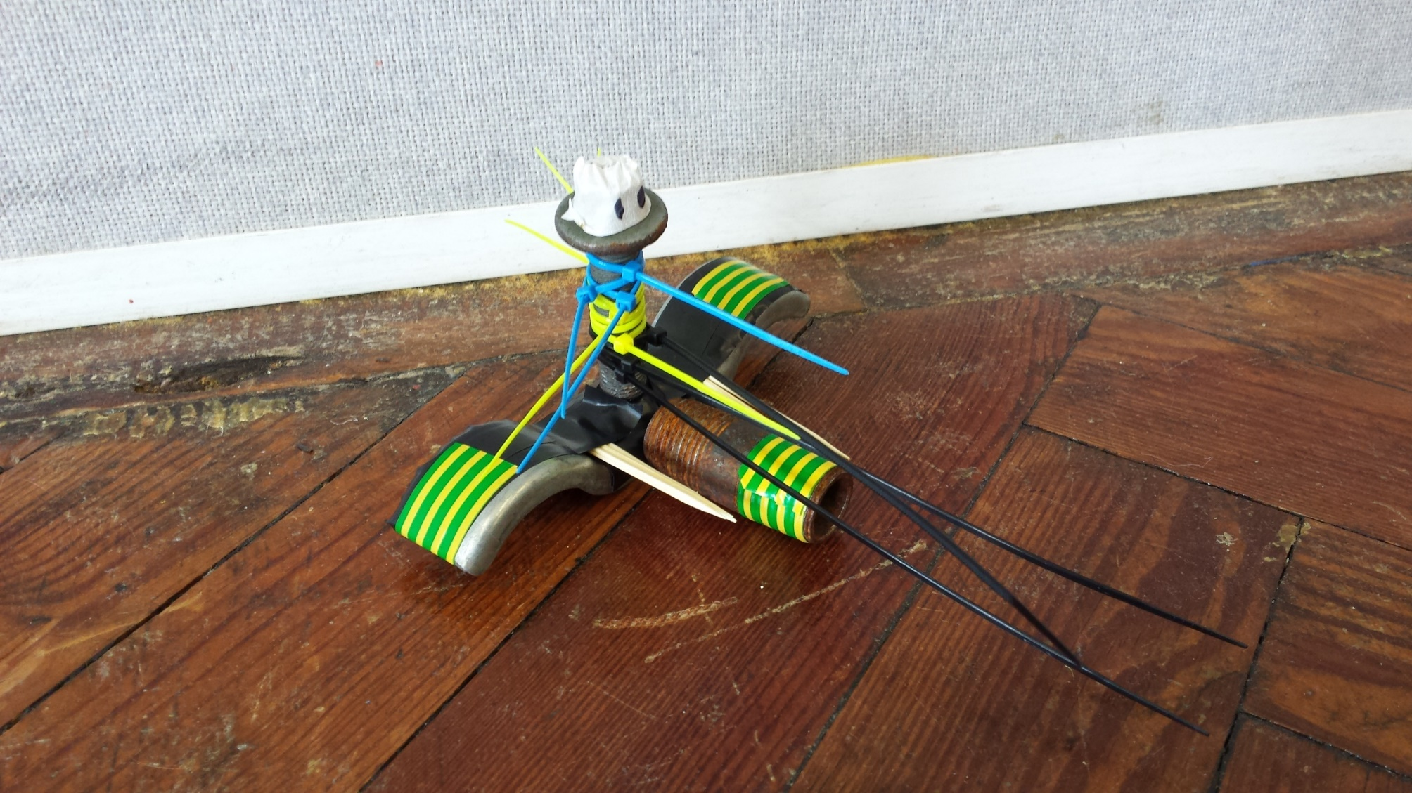
Making objects / characters
Recycled materials
Objects that become
protagonists
Why
Develop a personal relation
With their piece
How can students relate the
environment issues and with
every day actions
Global citizenship / student
agency.

Slide 4
Choose 3 parts of your object
Where were they made?
Who made them ?
Where did they travel?
What language would they speak?
Wooden frame
Metal strings
Felt in the pads
Write from the perspective of your object answering these questions
I come from | Je viens de | Vengo de | Ich komme aus
My … is from | Mon/ma …. est de | Mi.... viene de | Meine.... kommt aus
I was made by | J'ai été fabriqué | Fui hecho por | Ich wurde von gemacht
I arrived by | Je suis arrivé | Llegué por | Ich kam vorbei
I speak | Je parle | Hablo | ich spreche

Slide 5

Notes:
https://www.youtube.com/watch?v=9GorqroigqM

Slide 6
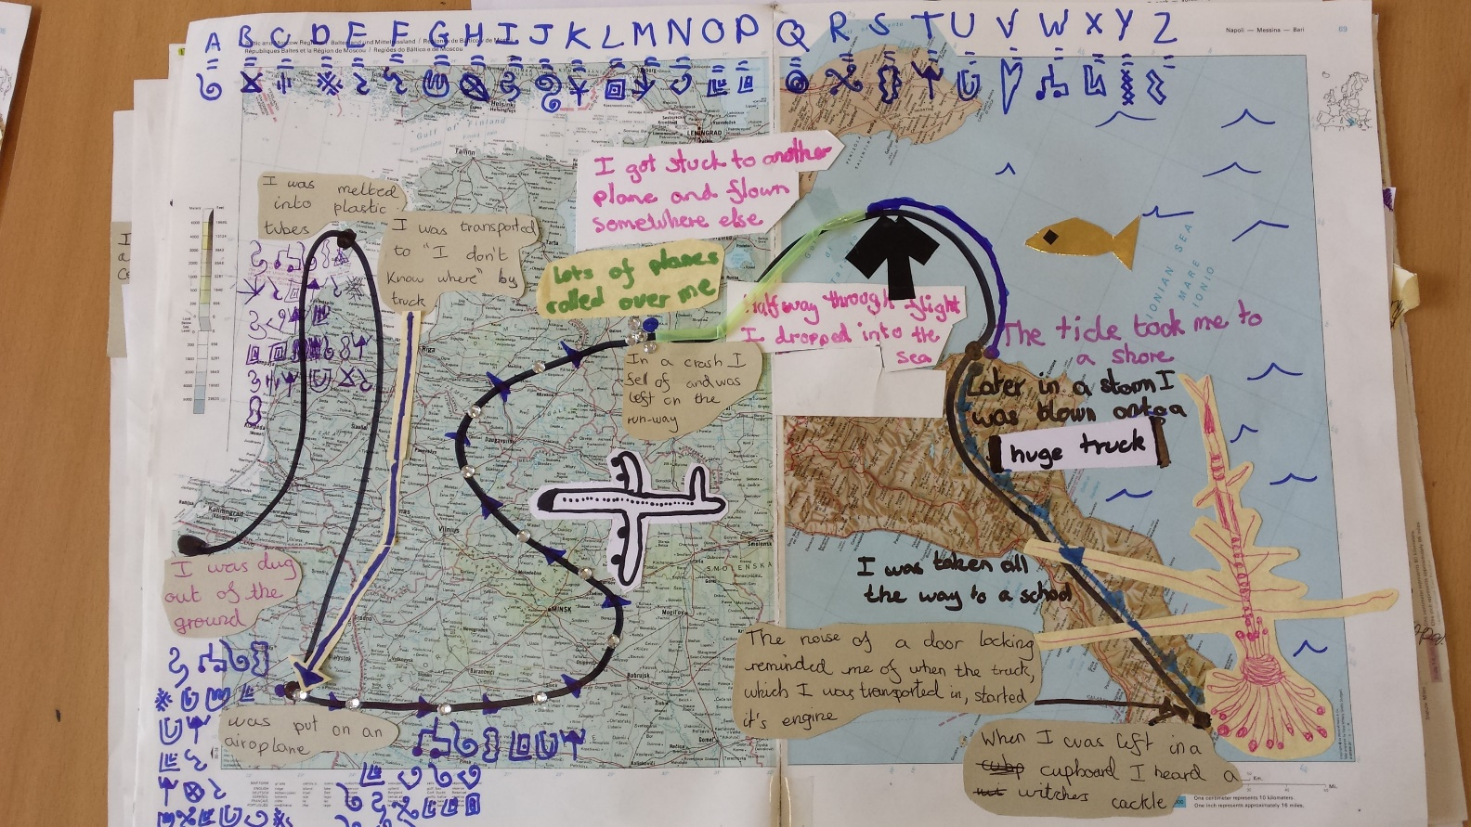
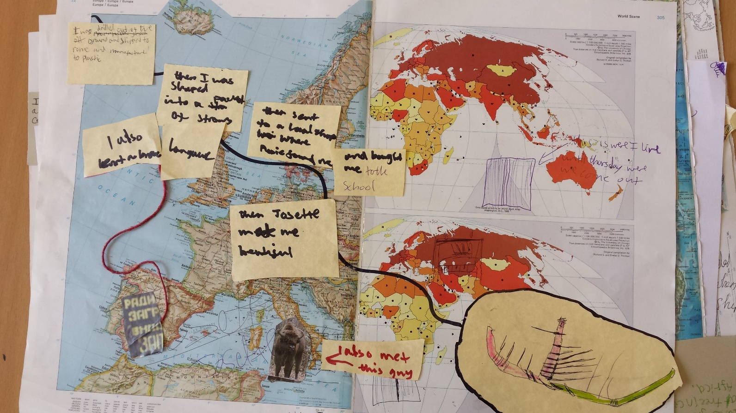
Journeys of composing parts
Life cycle of stuff

Slide 7
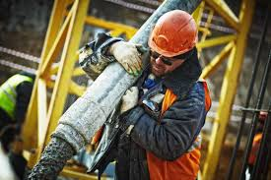
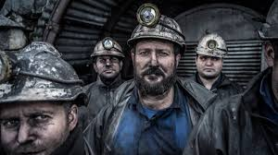
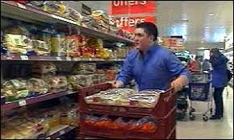
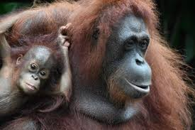
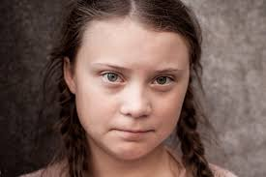
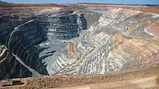
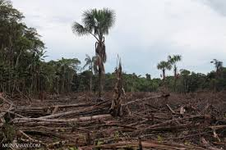
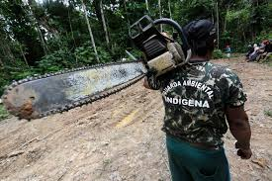
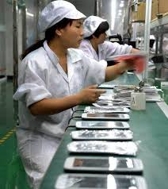
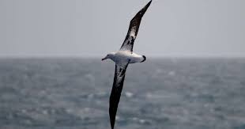
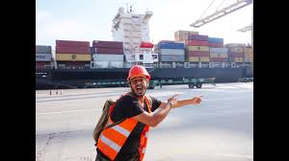
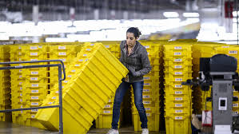
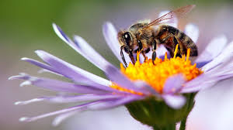
What would they say?
In which language?

Slide 8
Who or what would say these?
Si tu creuses toujours plus profond...
(if you dig deeper and deeper)
Si tu mangeais moins de Nutella
(if you ate less Nutella)
Si on n' avait pas découvert le pétrole
(if we had not discovered oil)
tu vas toucher mon coeur
(you going to reach my heart)
j'aurais des arbres pour dormir
(I would have trees to sleep in)
le monde serait plus lent!
(the world would be much slower)

Slide 9



Mats
Teammates
Teachers
You are talking in the voice of a person / animal / plant etc.
To you, your object, the government, children, adults...
In any language you can imagine they would speak (and that you can write in!)
There are other poems you can take inspiration from (if I dreamt big, if there were no oil, What can we live without)

Slide 10
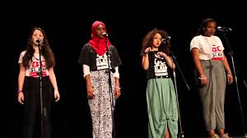
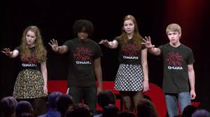
Session 2 – Group poems
List ways in which the poem is made as a group
  Consider the writing
  And the performance (who talks ? When? What other things do they do?)
Notes:
https://www.youtube.com/watch?v=Mlfnw26gH4I (global warming duet)
https://www.youtube.com/watch?v=WnYMbKPWu-4 (group poem / languages / differnet personal experiences) from 3.47

Slide 11

In groups, combine your writings
Consider
  Reusing what you have done
  How are languages going to alternate?
  Does it have to Rhyme (probably not)
  Are you honing on one theme or making a list poem?

Slide 12
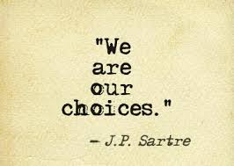

Session 3 Practice your piece
Who is talking and when?
  Unison
  Alternating ( sentences or words)
How are you standing (line, square…)
Gestures?
  Less is more
Be Loud

Slide 13
Look (Sirca)
Look what we’ve done sirca
We burn our woodlands and forests
And cut down the trees for paper
planted our destructive seed
Look what we’ve done
Poisoning the food chain,
the land, and polluting precious mother
Nature provides us with all we need
Look, what we’ve done
Like fast food propaganda
Pumping animals with steroids
Look what we’ve done
If we place the 480 billion plastic
bottles sold each year from end to end
they’d extend half-way to the sun.
Look what we’ve done.
Every day, eight million pieces of plastic
end up in the oceans and seas turned
into toxic dumps
where dolphins, turtles and whales can’t breathe
We are like Great White Sharks circling
greed to feed insanity
Look what we done
Our thirst for oil spills into rivers like tears
We choke and blacken the world’s lungs when we need oxygen
Look what we done
But still, we keep digging, digging for oil digging for treasure,
Dig our own graves
can you see what we’ve done?
Our stratosphere’s a rubbish dump filled with nuts and bolts discarded from spacecrafts aiming to reach the stars
we may never get to see
So, look
Before it’s gone.
The winner of the poem for Best Feeling in the South Ken Festival Multilingual Slam 2019/2020

Slide 14
When I was trapped by language,
It was just too hard to manage,
It did a lot of damage,
And my confidence was sandwiched.
Als sprache mich gefangen nahm, (When I was trapped by language)
Und ich dann in die schule kam, (And I came to school)
Konnte keiner mich verstehen, (No one could understand me)
Und wit konnten’s nicht umgehen. (We weren’t able to avoid it)
Cuando el idioma me entrapaba, (When I was trapped by language)
En el camino de comunicación, (On the road to communication)
Con paredes y barricadas es como caminaba, (With walks and barricades is how I walked)
¿Los puedo derrumbar y tener conversación? (Can’t I demolish them and have a conversation?)
Here we are,
No longer trapped by language,
Ya no entrapadas por el idioma, (No longer trapped by language)
Wir sind nicht mehr von fremdspraenen gefangen. (No longer trapped by language)

Slide 15
Podemos echarle la culpa a todo lo que nos rodea We can blame everything around us
Ma la verità è che non ne ho idea, But the truth is that I have no idea
È difficile assumersi le responsabilità It’s hard to take responsibilities
Y decidir tomar en tus manos la vida. And decide to take life in your hands
Porque podría ser culpa del tiempo Because it could be the weather’s fault
Ou du trafic Or the traffic’s one
Mais si je suis en retard But if I’m late
La colpa è mia in verità. The truth is that’s my fault
Ils disent « il n’y a rien de qu’être inquiète » They say “there’s nothing you need to be afraid of
But I need to be honest to let
The truth breath.
Nunca es fácil como querrías It’s never as easy as you want
Being a student, un amigo o una hija, a friend or a daughter
Mais tu ne peut pas te cacher But you cannot hide
Parce que on dépend de soi même Because we depend on ourselves

Slide 16
How to prepare for the workshop
Introduce ideas of where stuff comes from
What are the main materials in our stuff / where can you find them (oil, metal, wood, etc.) / what gets destroyed in its production.
Play with these ideas in different media (sculptures, maps, stories, poems).
For EAL, bank of things their parents say to tell them off, to praise them, to show love, pain, etc. Or bank of key words related to theme.
Practice writing poems in the target language using simple frames (list poems, if clauses, I like/I dislike, etc.). Low stakes and frequent.
Share results with me before workshop (I can have these as starting points)

Slide 17
General Rules for Multilingual workshops
Fluency > accuracy
Offering several ways in (multimedia, free writing/constraint writing, discussions, etc)
Teachers must take an active part, modelling activities, showcasing the creative process, sharing their work, writing/working alongside students.
Students to work in groups: ideally with different
  Languages
  Ages
  Proficiency
  Background
  Trust group intelligence to come up with a group piece…
Notes:
ffere

Slide 18
Poetry resources
OULIPO (constraint writing) / Glynn Maxwell (on Poetry)
Teacher poems
Brave new voices (youth poetry slam) / Spoken Word Education
https://www.youtube.com/watch?v=UCUz2b050lE&ab_channel=
SearchforCommonGround
  https://www.youtube.com/watch?v=WnYMbKPWu-4&t=250s&ab_channel=ApplesandSnakes

