Slide 1
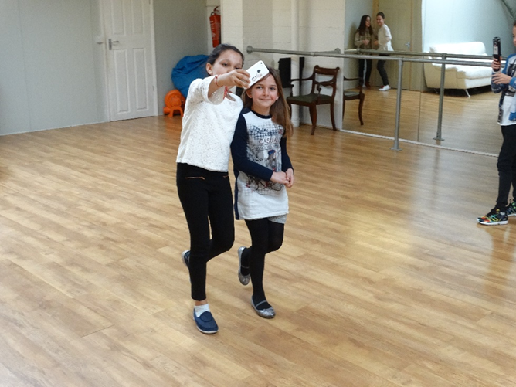
Practical pre-production and production MDST workshop
Mirela Dumić & Vicky Macleroy

Slide 2

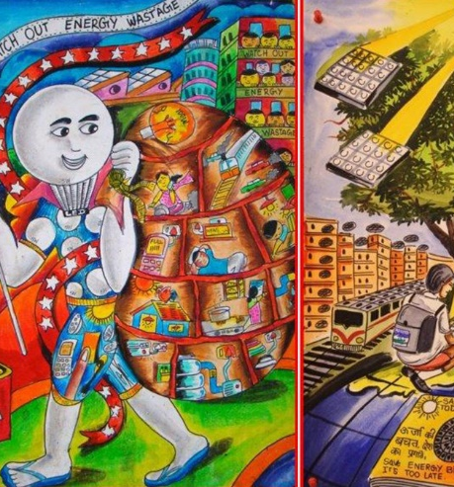
Main aims for the MDST workshop
To experiment with creating a multilingual digital story collaboratively.
To learn how to use a digital tool to tell an intercultural story on the theme of Our Planet.
To reflect upon the process and potential for using MDST in your school environment.

Slide 3
Object-Based Activity
Artefacts ‘can link literacy, multimodality and material culture together by focussing the lens on meaning making that is situated and material’ (Pahl & Rowsell, 2012).
What stories can your object bring out?
Object

Slide 4
Artefacts relating to ‘Our Planet’
Drama-based activities (developed by Chryso Charalambous)
Warm-up activity - name your object
Walk in the space - share the space
Position your object – explore others’ objects
Find out facts – short interviews
Talk about objects – use two or more languages

Slide 5
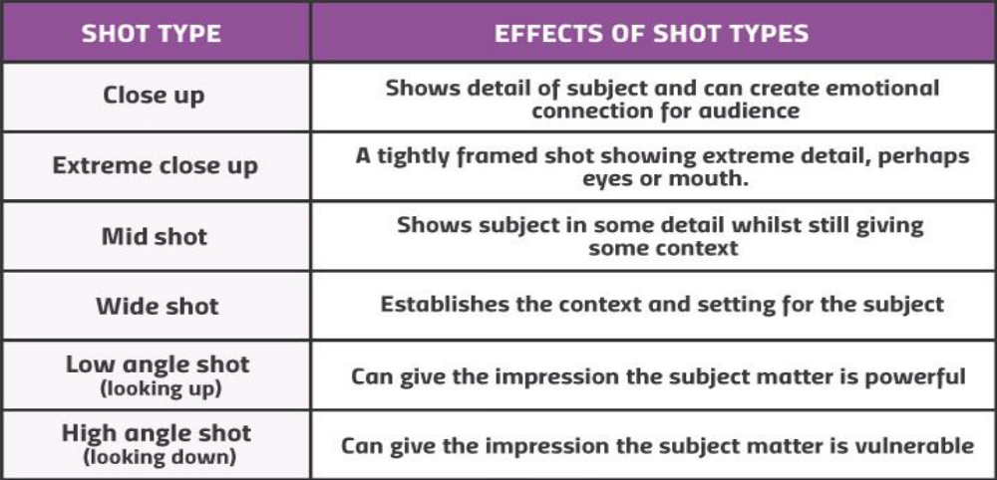
Camera shots and angles

Slide 6

Taking still photographs with iPads
Take two still images of your partner with their object but exclude their faces.
Capture your partner being proud of their object or as if they want to communicate something important about their object.
Capture your partner protecting their object.

Slide 7
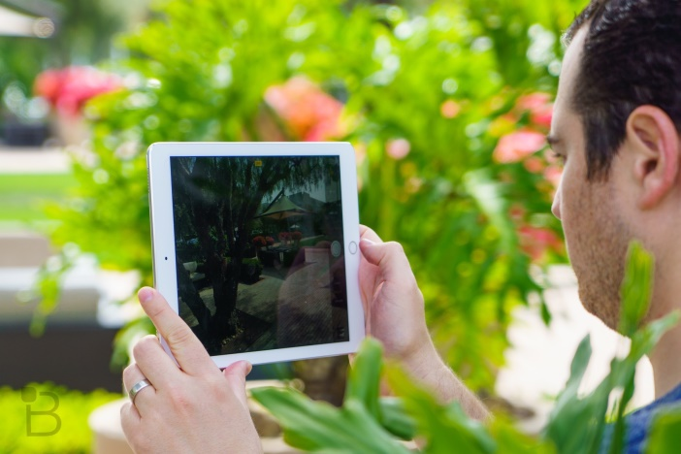
Filming with iPads
Filming activity:
Repeat the final activity from the drama work ‘talking about objects’ and this time film your partner.
Playback the recording and check for visual and sound quality.
Landscape mode

Slide 8
Storyboarding
Use the template to complete a storyboard with a sequence of short scenes based on at least one of your objects:
Share ideas about the theme of Our Planet and how you can represent the main message.
Discuss the overall narrative sequence of 6-8 frames.
Decide on the potential setting for each frame.
Develop a short script for each frame in a language other than English.
On location – decide on camera shots and angles.
Create your storyboard in small groups.

Slide 9
Script
Shot no.
Audio texts /Sound effects
Camera directions
Image/video description: | Image/video filename:
Text on screen (subtitles):
Animation/Interaction:
Notes:
Notes:
Talk through

Slide 10
Filming on location
Film activity:
Decide on roles for the filming process (these may change around).
Collect props and resources for filming as well as your objects.
Check on lighting and sound in the selected locations.
Decide on camera shots and angles for each frame or moving image.
Be economical on filming and delete all unnecessary shots and film footage.
Complete all filming for your 3-minute digital story.

Slide 11
Task Sheet
Film Brief:
Complete a 3-minute bi- or multi- lingual digital story in the target language(s) with English subtitles.
Work with the theme Our Planet and decide how you can represent the main message.
Base your digital story on at least one of your objects.
Create 8 different shots/scenes to tell your story.

Slide 12
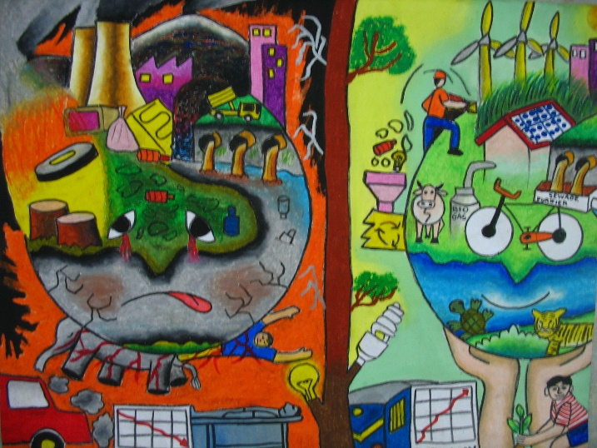
Final Product
A 3-minute collaborative multilingual digital story representing unity in multilingualism on the theme Our Planet.

Slide 13
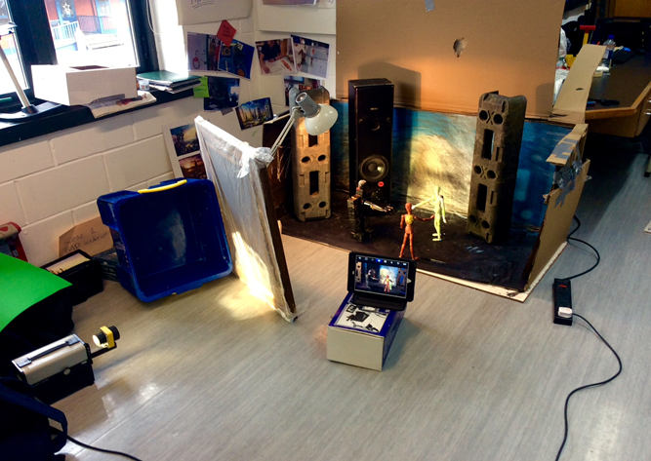
Practical post-production MDST workshop
Mirela Dumic & Yu-Chiao Chung

Slide 14

Film production and editing
iMove for iPad
It enables you to create a short film
You can assemble video clips and still photos, add music and sound effects, record a voiceover, add subtitles, and apply filters or a theme to add a professional look and feel.
Simple intuitive interface: Let’s learn together!

Slide 15
Film production and editing
We’ll learn how to:
Create a Movie Project
Import video clips and photos from Photo Library
Undo / redo an action during editing
Arrange video clips and photos on the timeline
  Trim a video clip or photo (change duration on the screen, remove unwanted sections)
  Remove a clip / photo from the project
Adjust the movement of photos (zoom in / out) and speed of video clips
Apply filters – cinematic touch (black &white, change colour)
Insert and arrange audio clips
  Record voiceover directly into the project
  Add music and sound effects
  Adjust audio (volume)
Add subtitles/translation and credits
Upload your film into a shared folder

Slide 16
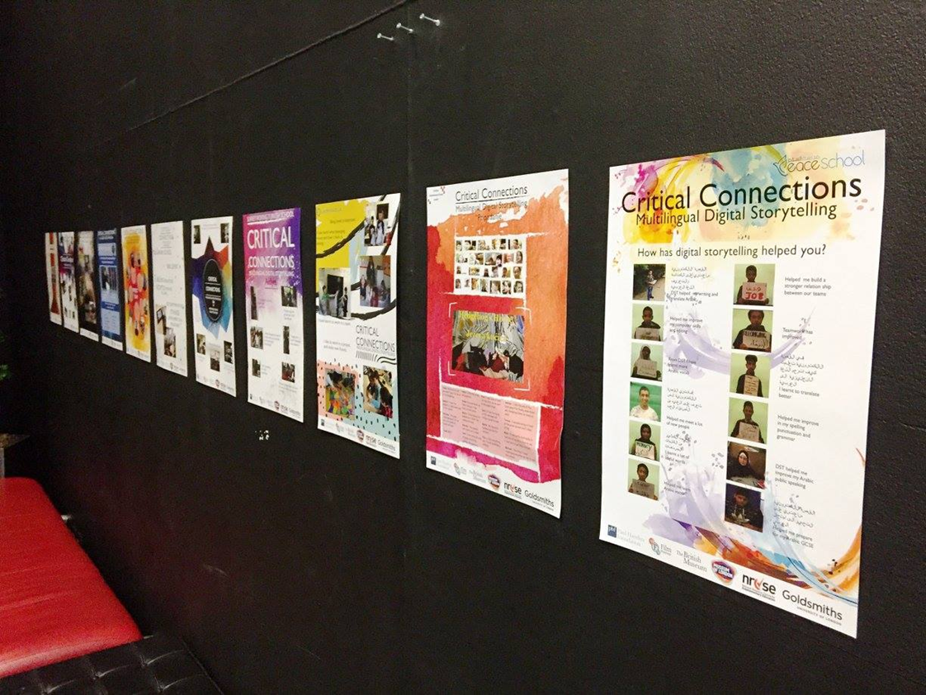
Showcase and Implementing MDST in your classroom

Slide 17
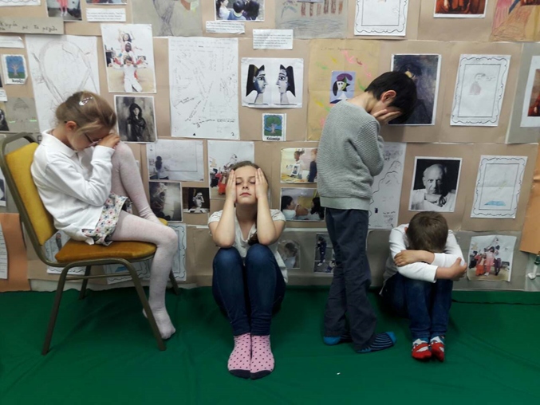
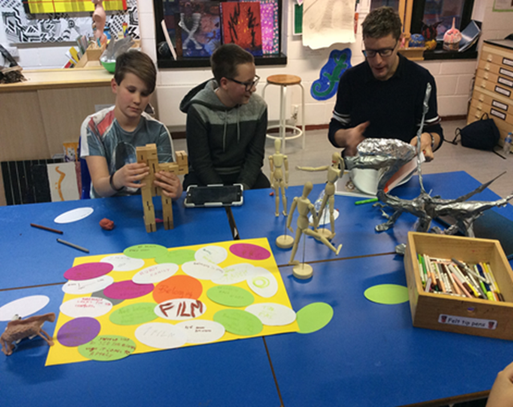
Implementing MDST in your classroom
Reflection and discussion about strategies and classroom principles and practices with MDST.

