Slide 1
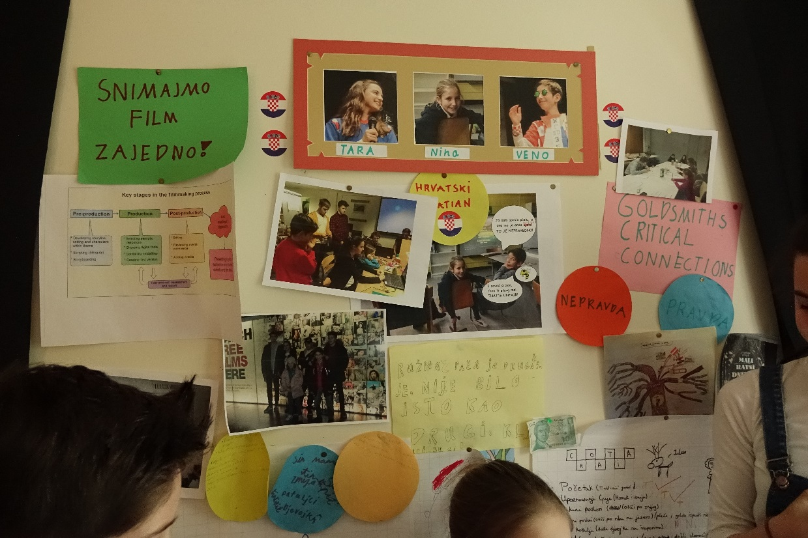
Migrating Texts: Adaptation and Translation Multilingual digital storytelling workshop
Mirela Dumić, International School of London, London
Dr Vicky Macleroy, Goldsmiths, University of London

Slide 2
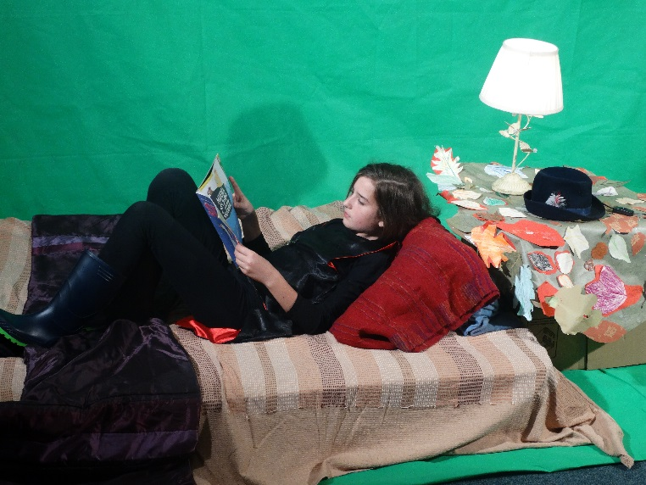
Main aims for the workshop
To experiment with adapting and translating a story.
To learn how to use a digital tool to tell a story.
To reflect upon the process.

Slide 3
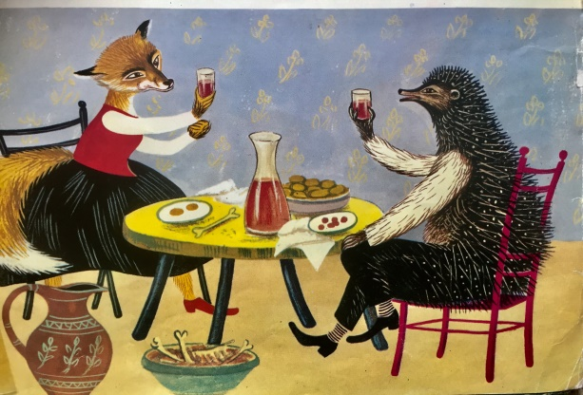
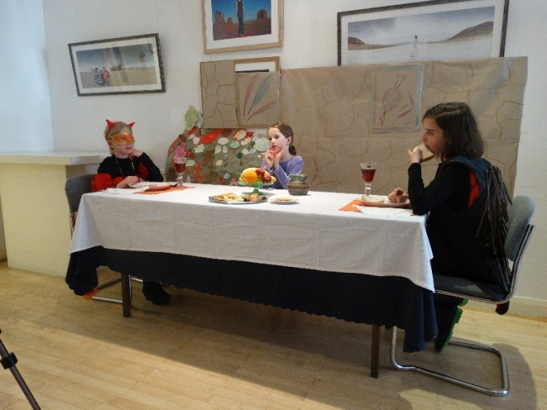
Hedgehog’s Home by Branko Ćopić
1. A story that crosses political divisions.
Hedgehog's Home by Branko Ćopić (1915-1984) was first published in Yugoslavia in 1951. Born an ethnic Serb, he was one of the former Yugoslavia's best known and most popular writers for adults and children. This was a story that could be recited by almost every Yugoslav adult and child since it first appeared. Despite the recent Balkan wars it has survived to become part of the culture of the newly formed republics of the early 1990s and the book still remains on the Croatian school curriculum (Serbian language adapted for Croatian audience).
2. A story that is a migrating text across languages and modes of production.
3. A story that is a multilingual digital story in our project (Critical Connections II).

Slide 4


Hedgehog’s Home: Summary
Hedgemond is a very determined and stubborn little Hedgehog who loves his home deep in the forest. When invited to dine with the charming Miss Fox at her home in the quarry he is happy to accept. Over the course of the next four hours Hedgemond enjoys delicious food and delightful company, but with a long journey ahead of him, he is soon anxious to be on his way. Despite Miss Fox's protestations and her attempts to persuade him to stay a while longer, Hedgemond is resolved to return to his own cosy home. He must have riches he has to protect thinks Miss Fox so she decides to follow him and find out. As she rushes after Hedgemond, Wolf, Bear and the wild Boar are also eager to know 'why hedgehog so loves his native abode!' so they all follow him in hot pursuit. The trouble is that the other animals of the forest simply don't understand why Hedgemond loves his home so much (except for the Fox).
1951
First time in English
Istros Books UK (2011)

Slide 5
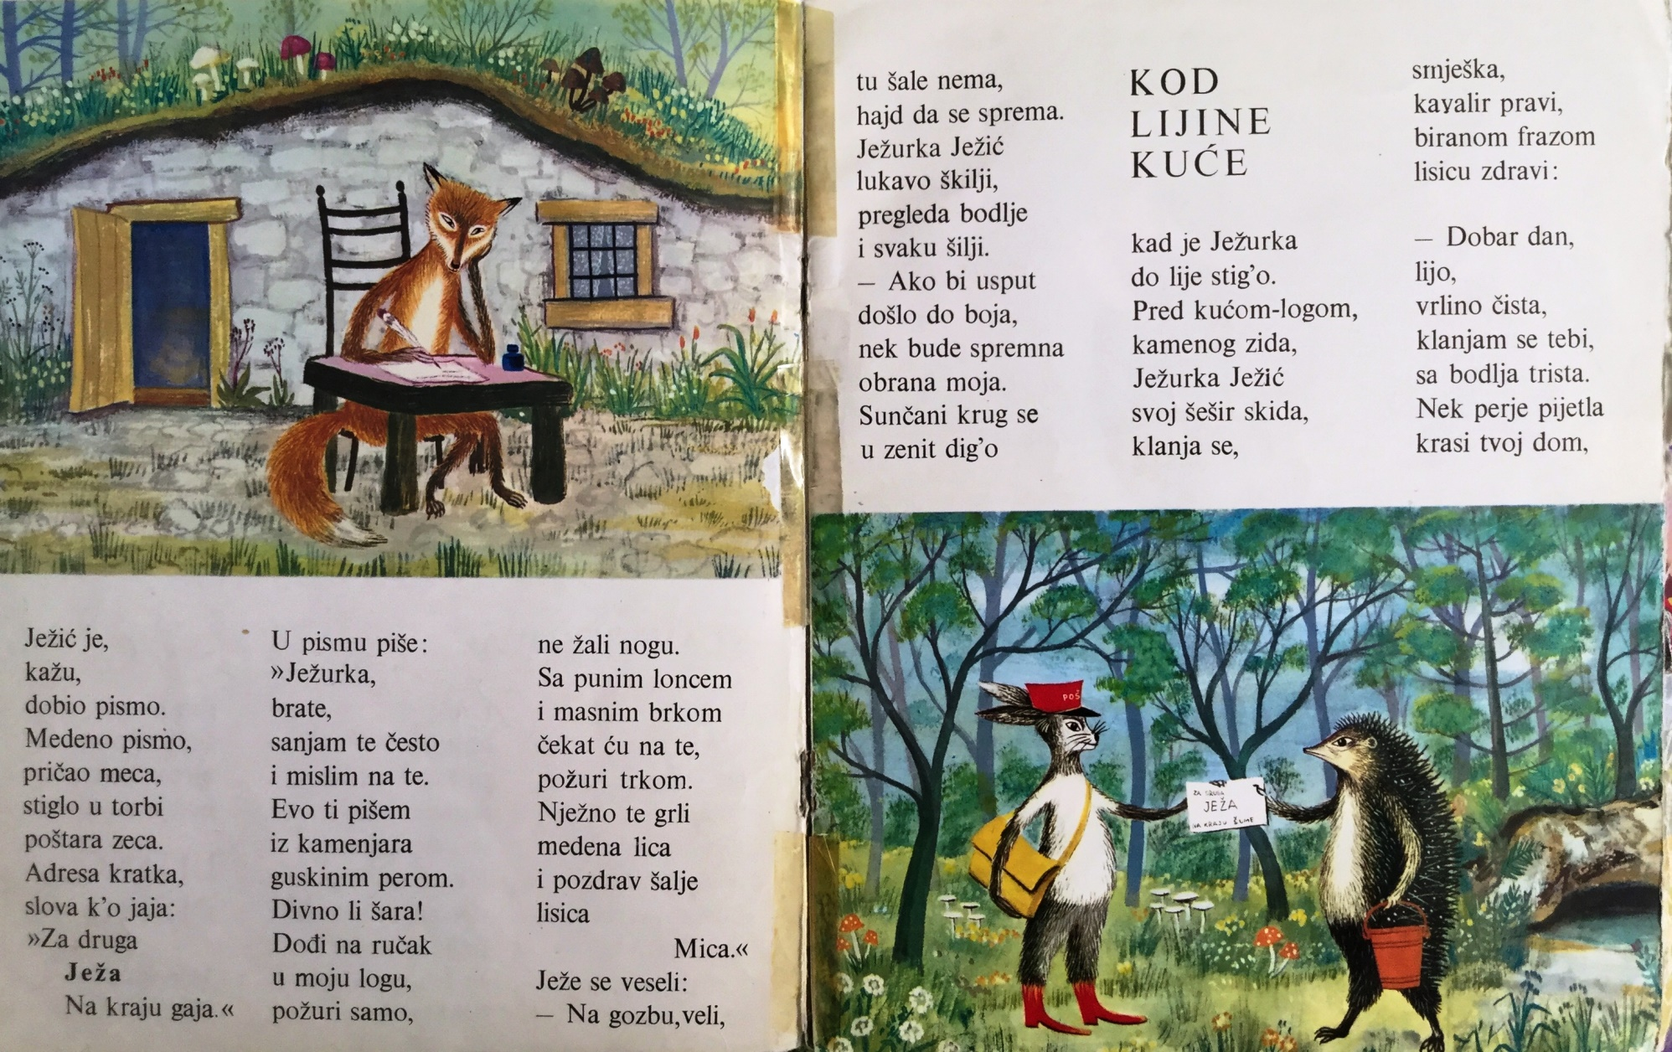
Hedgehog’s Home: A story in rhyme

Slide 6
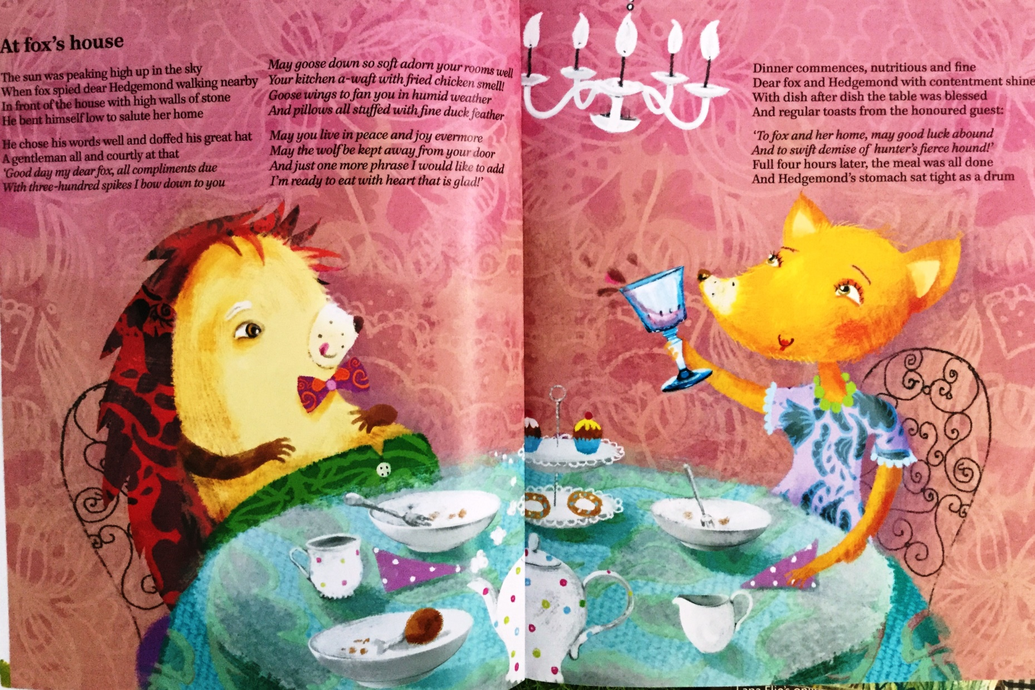
Hedgehog’s Home: An adaptation
Istros Books (UK), 2011

Slide 7
Hedgehog’s Home
Your adaptation for a digital story

Slide 8
Experiment with adapting and translating a story using Photo Story 3
Keep the main theme of ‘home’ for your story.
Select between 6 – 10 pictures from the picture book of Hedgehog’s Home.
Create your own title for your adaptation of the story.
Create narration for each picture, subtitles and insert music (use your languages).
Add special effects and think about camera angles and framing.
Preview your digital story and share with others.

Slide 9
Using Photo Story 3 as a tool
Demonstration
Photo Story 3 for Windows:
Easy to use, convenient for quick digital stories
Takes you step-by-step through the tasks
We’ll show you how:
Insert photos
Format text / main title
Add photo motion / special effects
Adjust timing
Add subtitling and narration
Add music (tempo and volume)
Save for showing on computer as MV file
Share with wider audience

Slide 10
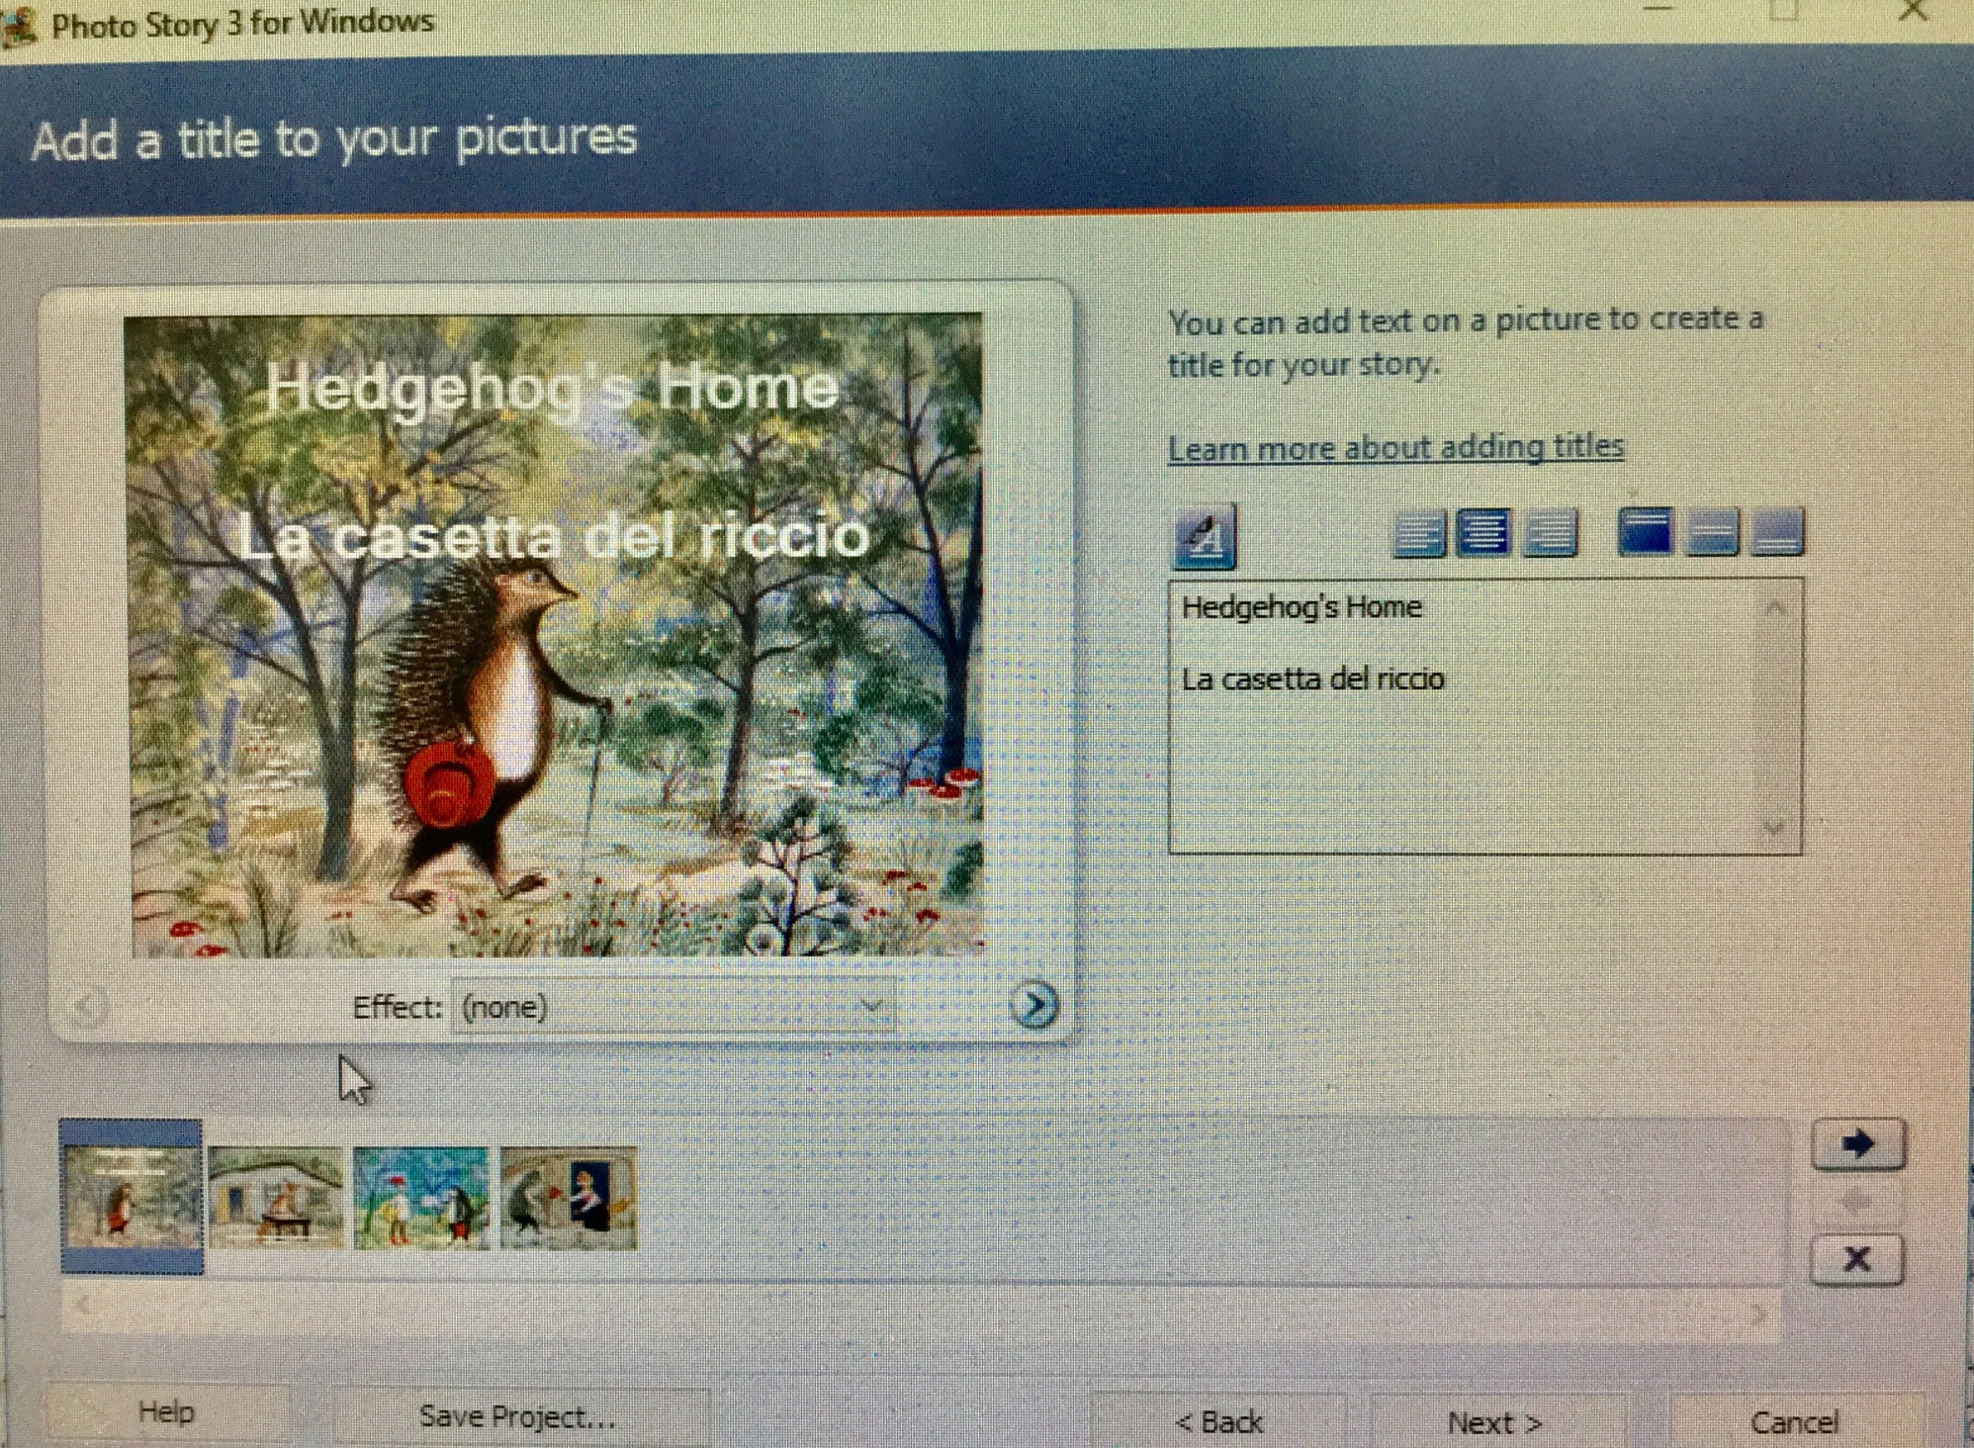

Slide 11
Sharing digital stories
Experimentation and reflection:
Identify hidden messages or preferred readings.
Examine language used and how language works across modes.
Locate social and cultural views in the texts and ask ‘Who has the power in this text?’
Interrogate text designs. What is the dominant mode? What other modes are used? Why these modes and not others?
Interpret how a text should be read and ask ‘What are other alternative readings?’

Slide 12
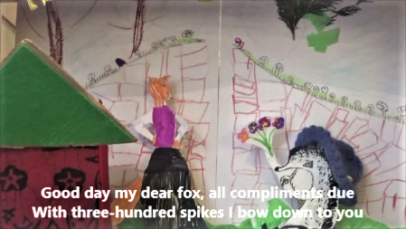
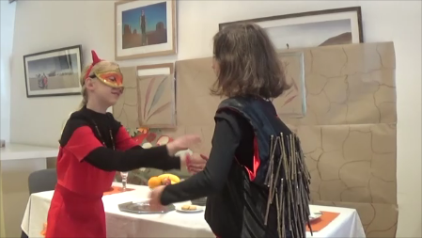
Hedgehog’s Home
Croatian Supplementary School (London)
Critical Connections II Project
A girl who takes comfort from reading one of her favourite books takes us on a journey of discovering how important it is to have a home where we feel we be-long regardless of its condition or size. A cross between Drama and Puppetry, this Croatian-English story within a story is an adaptation of Hedgehog’s Home, a famous Croatian book for children that has been cherished for generations.

Slide 13
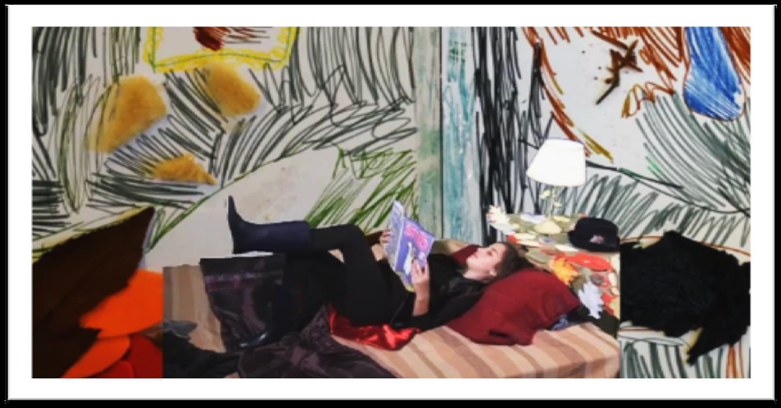
Poster on making the digital story
Maya: It was quite challenging to read lots of words in Croatian and it was hard to get them all right.
Adrian: I like the end of the book when Fox finally understood why Hedgehog loves his home so much.

Slide 14
Script
Shot no.
Audio texts /Sound effects
Camera directions
Image/video description: | Image/video filename:
Text on screen (subtitles):
Animation/Interaction:
Notes:
Notes:
Talk through

Slide 15
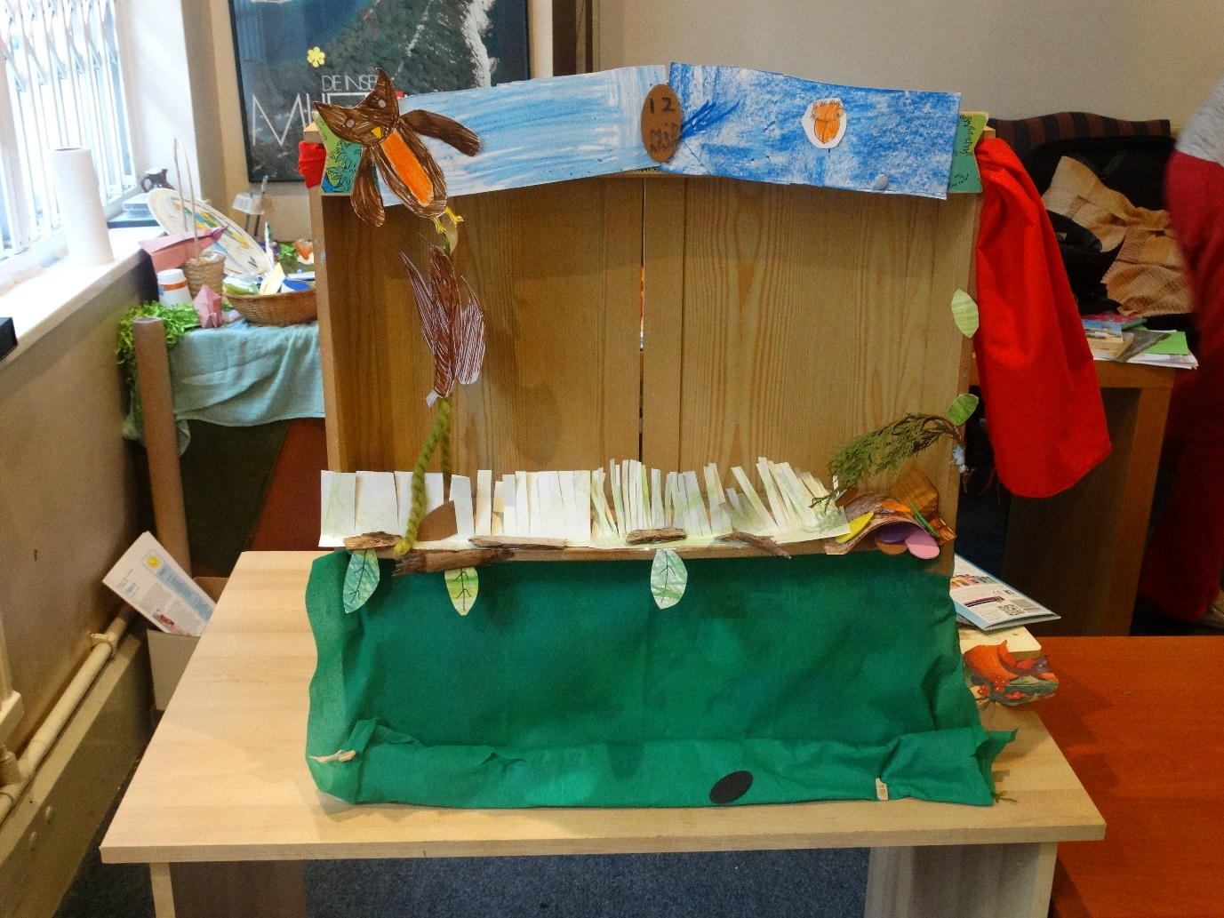
Critical Connections website http://goldsmithsmdst.com
See Handbook for Teachers: https://goldsmithsmdst.wordpress.com/handbook/

