Slide 1
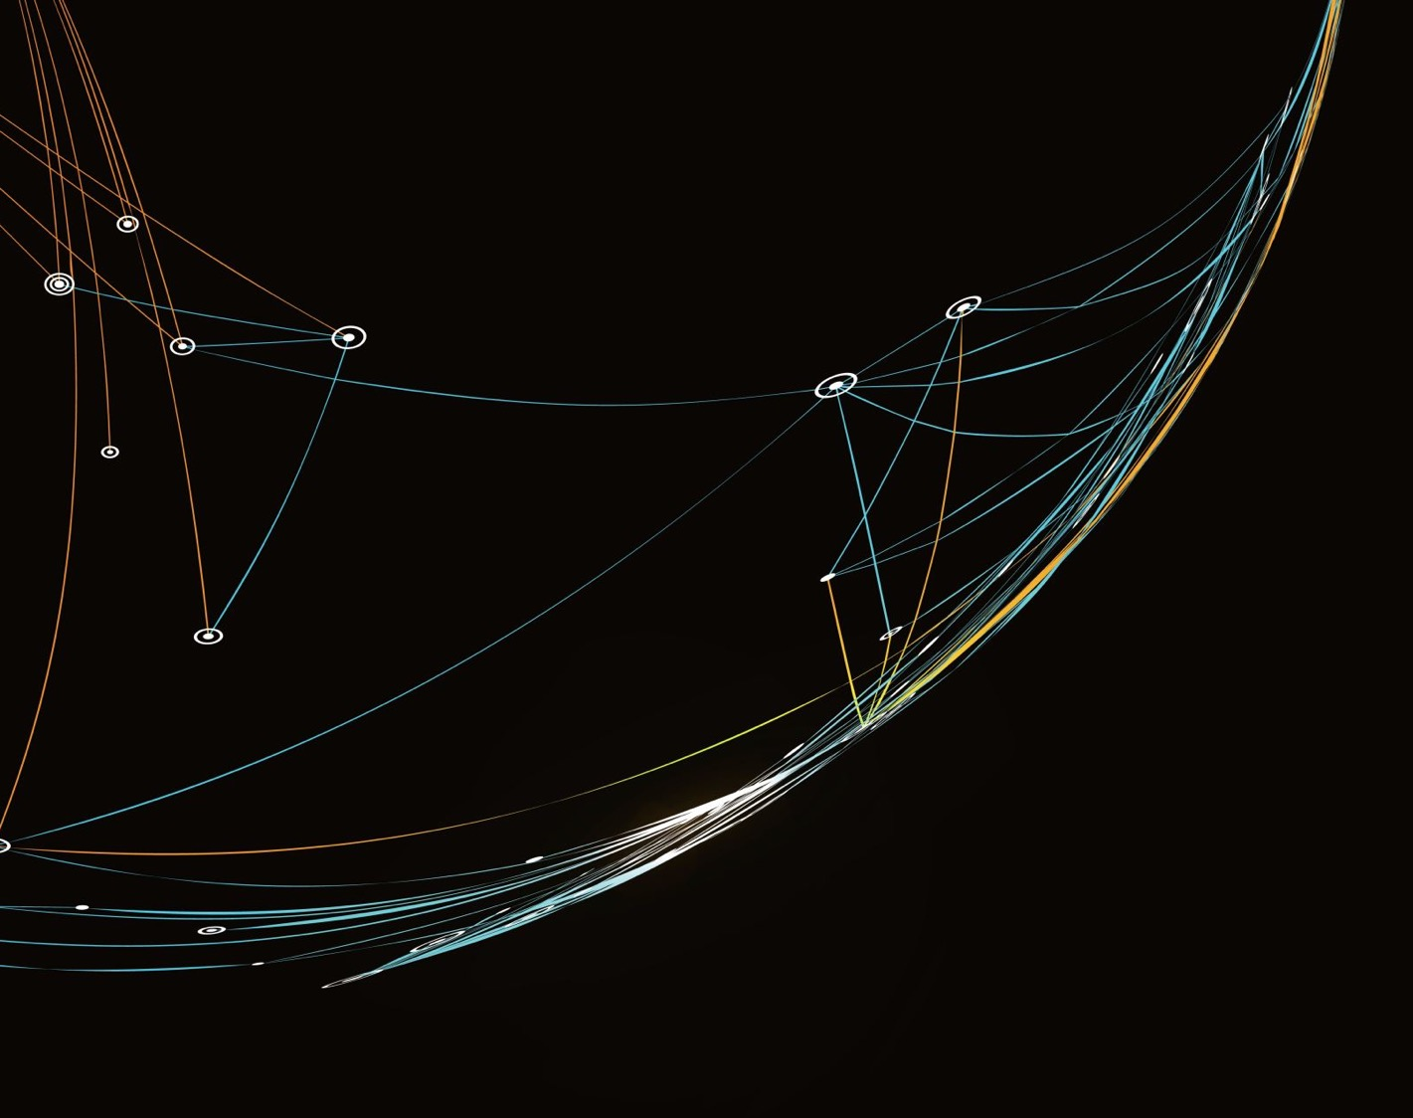

Critical Connections:
Multilingual Digital Storytelling Project
Professor Vicky Macleroy, Dr Jim Anderson, Dr Yu-Chiao Chung, Dr Judith Rifeserr
Workshop 4 - Pre-Production (storyboarding and mood boards)

Slide 2
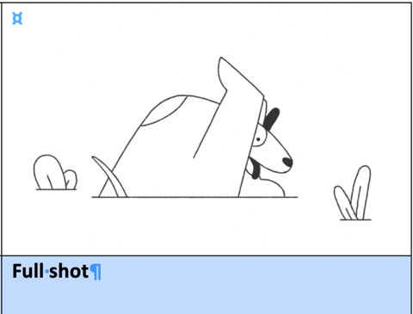
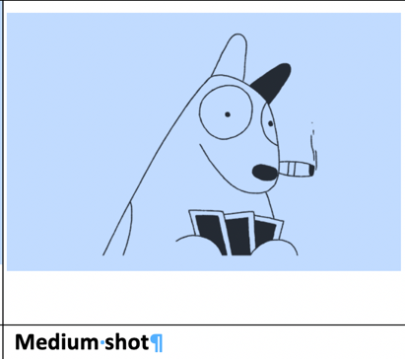
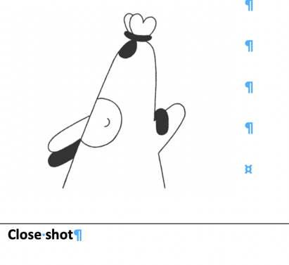
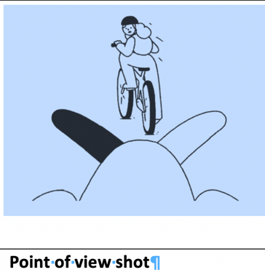
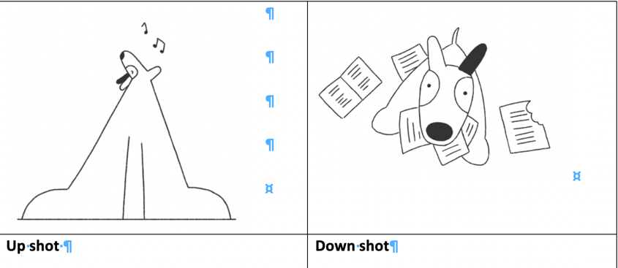


Pre-Production: Visual storytelling: Camera shots and angles
Explore the different type of shots
Where is the camera?
What does it tell you without words?
You can use these guides to help you find out more
.
@Connecta, University of Roehampton

Slide 3
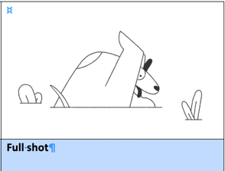


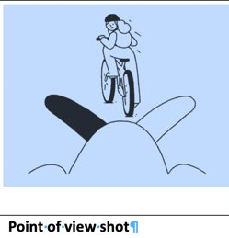
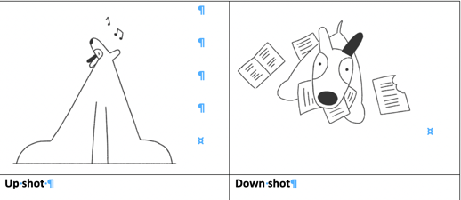
Pre-Production: Visual storytelling: Camera shots and angles
3. The characters face takes up the screen and this is used to focus on their emotions.
2. This is the opposite of an up shot and is taken from above eye level. It gives the impression that the character is powerless.
This shot is taken from below eye level and gives the impression that the character is dangerous or superior.
4. This shot shows the audience what the character is looking at. It allows the audience to understand the scene from the characters point of view.
6. Show the entire body of a character. It is used to focus on their movements.
5. This shows the character from the knees upwards and is used to show the character, environment and can focus on emotions.
a
b
c
Can you match the description with the correct shot?
d
e
f
@Connecta, University of Roehampton

Slide 4
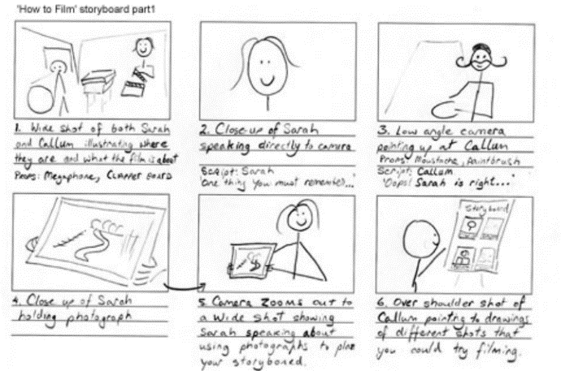
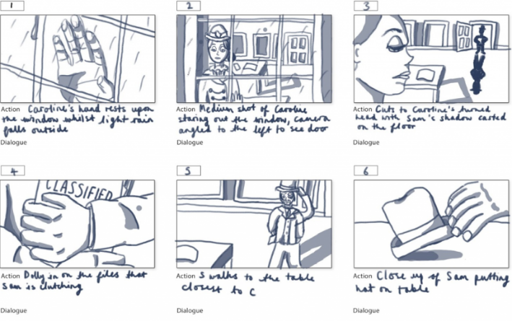
Pre-Production:
Props - Storyboard Example
Which props will you need for these stories?
@Connecta, University of Roehampton

Slide 5
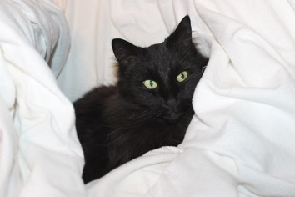
What can you hear?
Pre-Production: Audio-visual storytelling
I think I can hear:
a boy, a man, a woman, a girl
a door, a bell, a window, a car, a cat, a dog
a person playing : videogames, football, tennis
I agree.
I disagree.
Teacher: Play the video without visuals first. You can find the short film here. .

Slide 6
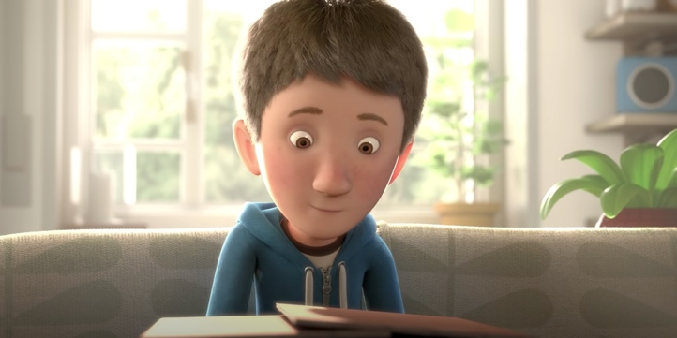
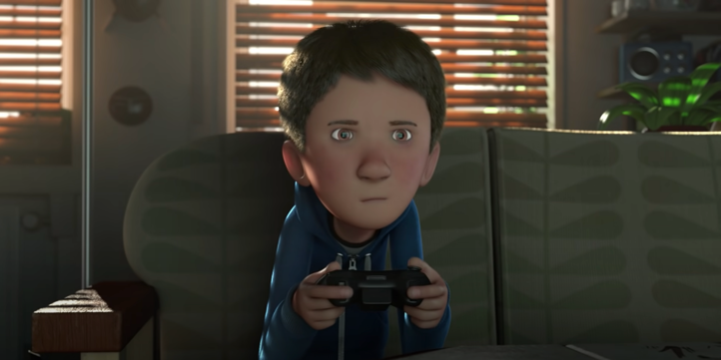
What is the difference in these two shots?
Pre-Production: Audio-visual storytelling
In shot 1 the boy is…
In shot 2 the boy is…
dark/ bright/ light

Slide 7

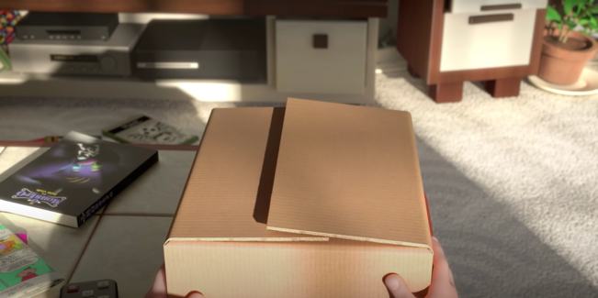
Where is the camera?
Pre-Production: Audio-visual storytelling
Point-of-view shot (POV)
Close-up
In shot 1 the camera is…
In shot 2 the camera is…
The camera here is close/far…
in the front/ in front of…
in the back/ behind…

Slide 8

What will happen next?
Pre-Production: Audio-visual storytelling

Slide 9
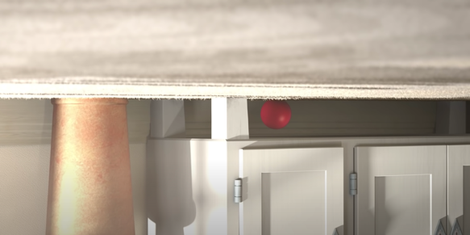
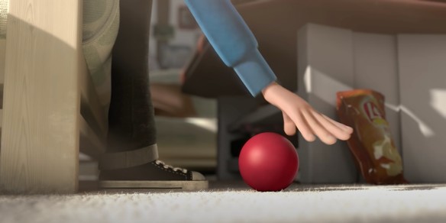
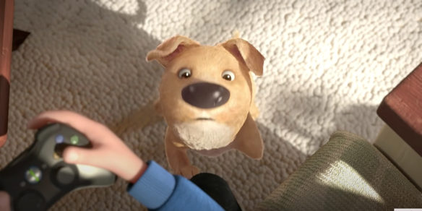
Whose point-of-view/perspectives are we seeing?
Pre-Production: Audio-visual storytelling
(Extreme) high angle shot (Bird-eye view)
In shot 1/2/3 we can see the perspective of …
In picture 3 the camera is at the top/bottom. The dog is big/small here.

Slide 10
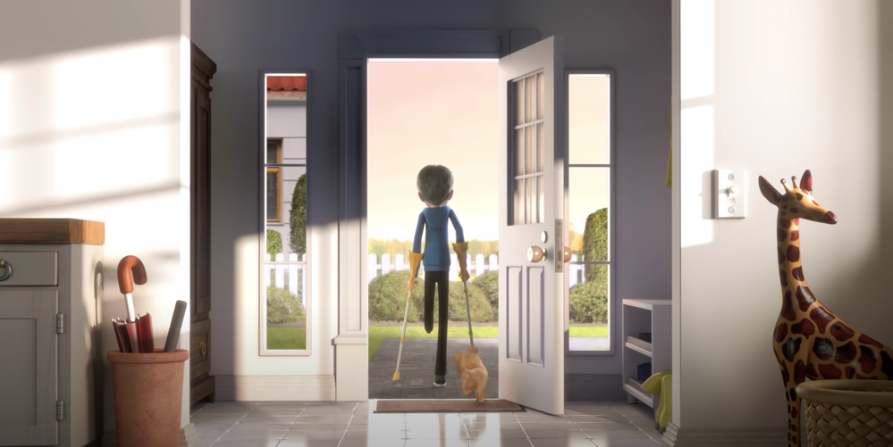
What can you see?
Pre-Production: Audio-visual storytelling
Why is this shot called a wide shot or long shot?

Slide 11
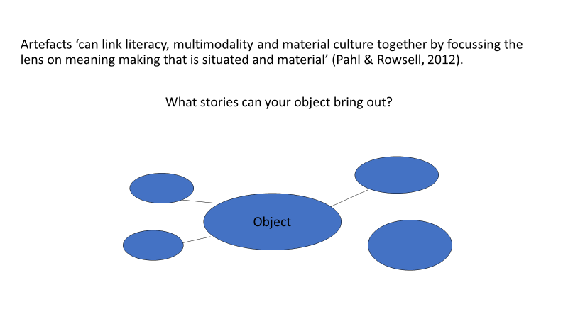
Pre-Production: Exploring objects

Slide 12

Warm-up activity - name your object
Walk in the space - share the space
Position your object – explore others’ objects
Find out facts – short interviews
Talk about objects – use two or more languages
Pre-Production: Exploring an object from different angles and perspectives

Slide 13
Take a still image of your partner with their object but exclude their face.
Take a still image of your partner being proud of their object.
Take a still image of your partner as if they want to communicate something important about their object.
Take a still image of your partner protecting their object.
Pre-Production: Taking still images of your object

Slide 14
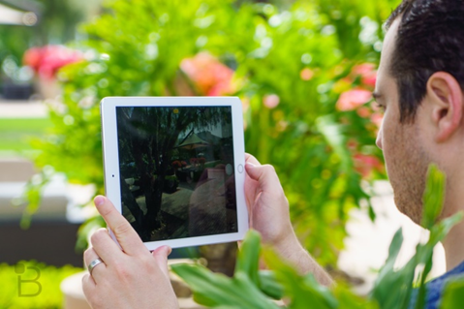
Repeat the activity ‘talking about objects’ (in two or more languages) and this time film your partner.
Playback the recording and check for visual and sound quality
Pre-Production: Filming with objects
Landscape mode

Slide 15
Use a template to complete a storyboard with a sequence of short scenes based on at least one of your objects:
Share ideas about the theme of ‘Care, Community and Hope’ and how you can represent the main message.
Discuss the overall narrative sequence of 6 - 8 frames.
Decide on the potential setting for each frame.
Develop a short script for each frame in a language other than English.
Decide on camera shots and angles.
Create your storyboard in pairs, small groups or individually.
Pre-Production: Storyboarding activity

Slide 16

Pre-Production: Audio-visual storytelling
SCENE #:
SHOT #:
SHOT SIZE:
SCENE #:
SHOT #:
SHOT SIZE:
SCENE #:
SHOT #:
SHOT SIZE:
Use the storyboard template to sketch out the main scenes of your own story.
SCENE #:
SHOT #:
SHOT SIZE:
SCENE #:
SHOT #:
SHOT SIZE:
SCENE #:
SHOT #:
SHOT SIZE:
Create your free storyboard at studiobinder.com

Slide 17
Script
Shot no.
Audio texts /Sound effects
Camera directions
Image/video description: | Image/video filename:
Text on screen (subtitles):
Animation/Interaction:
Notes:
Notes:
Talk through

Slide 18
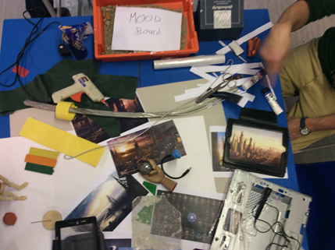
Create a mood board to share the visual style of your film.
See an example in the image of creating a mood board for the B.A.D. Robot digital story from ISL Surrey: https://vimeo.com/220581681
Pre-Production: Creating a mood board

Slide 19
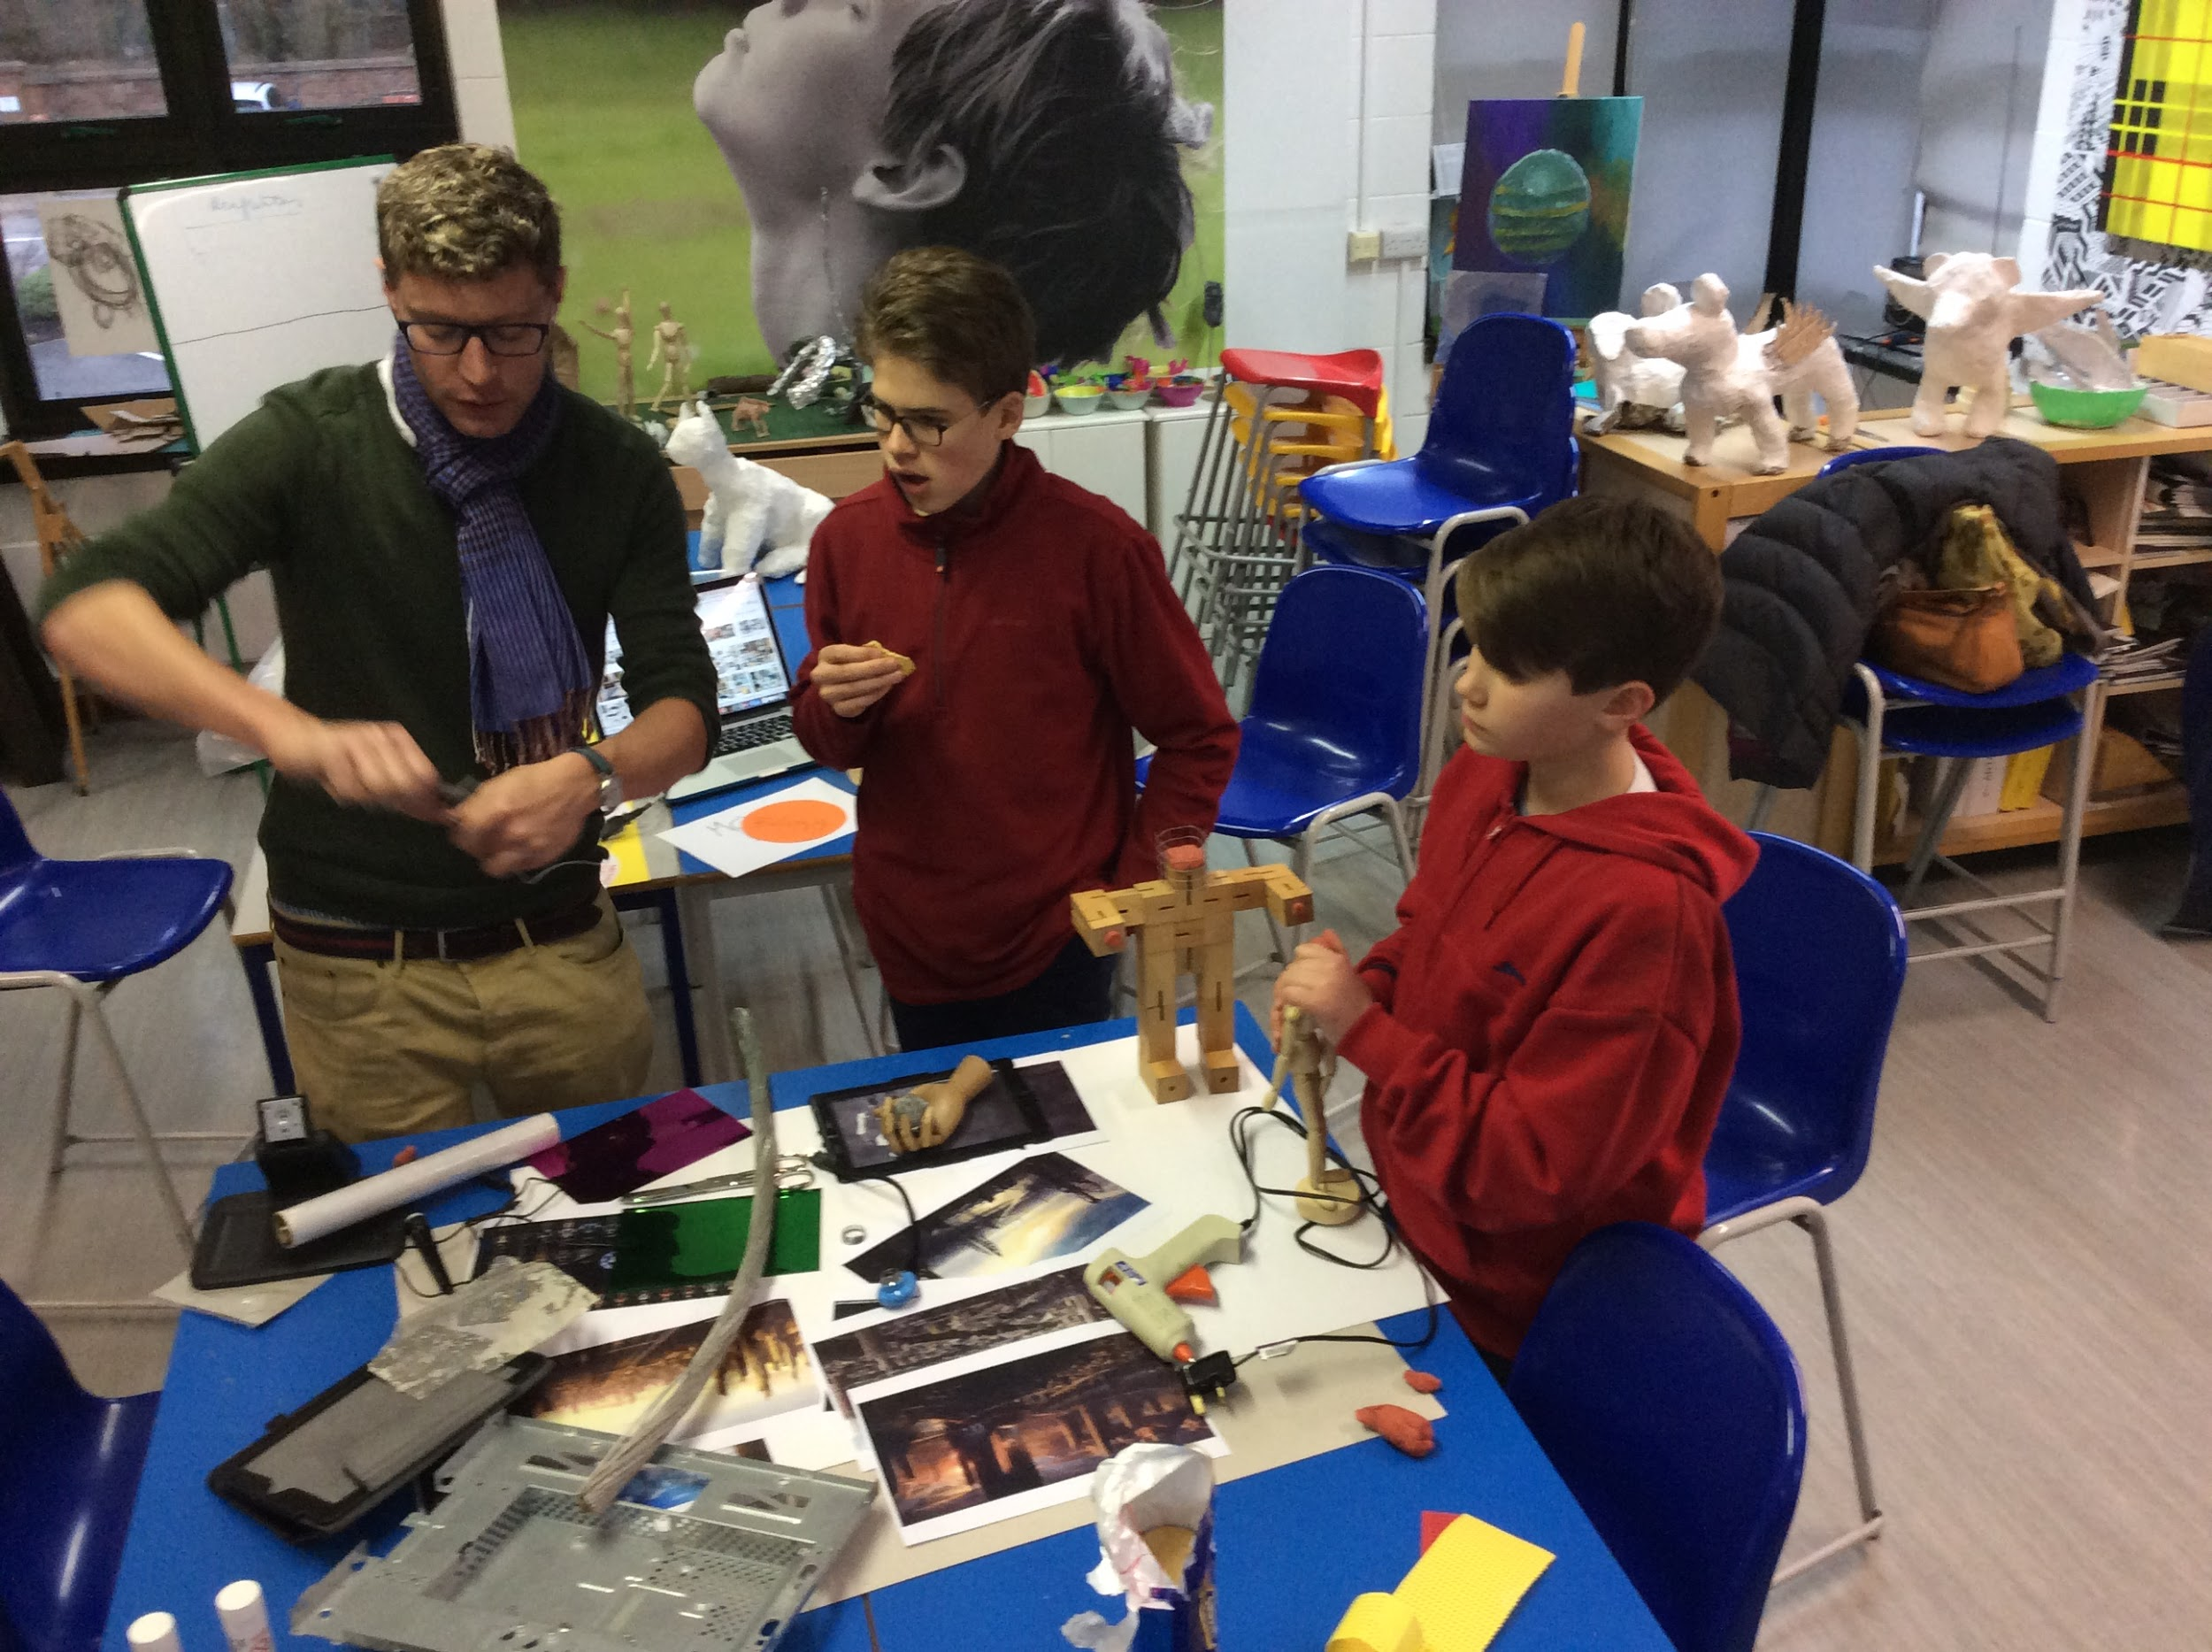
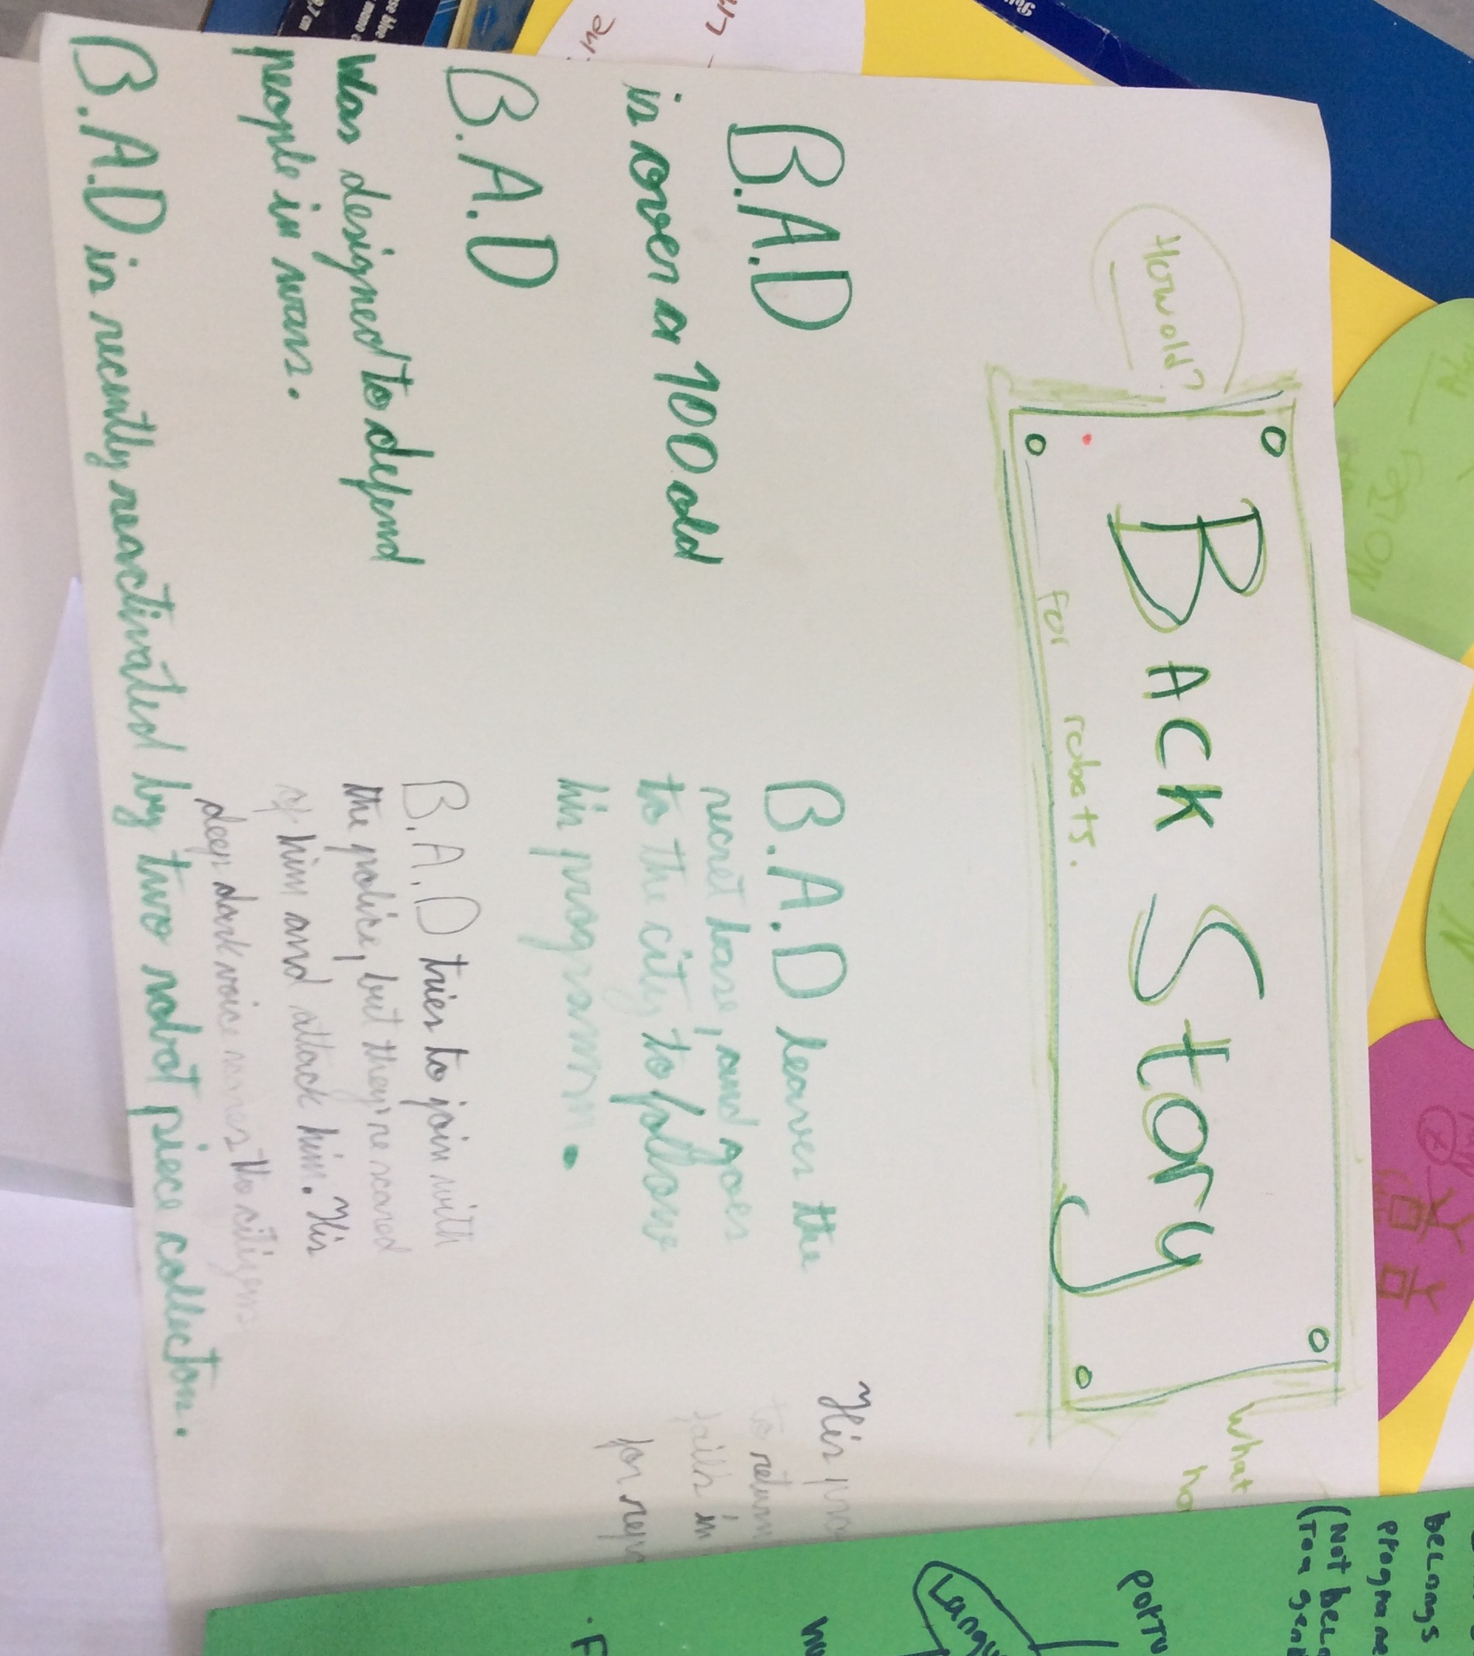
The Art teacher viewed improvisation as a large source of creative power and strongly believed in an open classroom structure, so he filled the classroom space with robotic materials, electronic junk and old computer parts. The young people were experimenting with objects and building their digital story out of junk and old computer parts, creating mood boards, taking photographs, and learning skills of stop-motion animation that require collaboration and team work.
Writing a back story for their robot character (name, voice, experiences, age, story) was a key decision point in the making of the digital story and led to experimentation with voices in Hungarian, Portuguese and English (p. 210).
Macleroy, V. (2019) Object narratives, imaginings and multilingual communities: Young people’s digital stories in the making. In A. Moutsios-Rentzos, A. Giannakoulopoulos and M. Meimaris (Eds) Proceedings of the International Digital Storytelling Conference Current Trends in Digital Storytelling: Research & Practices. Zakynthos: UNESCO Club of Zakynthos
Pre-Production: Mood boards and character back stories

Slide 20
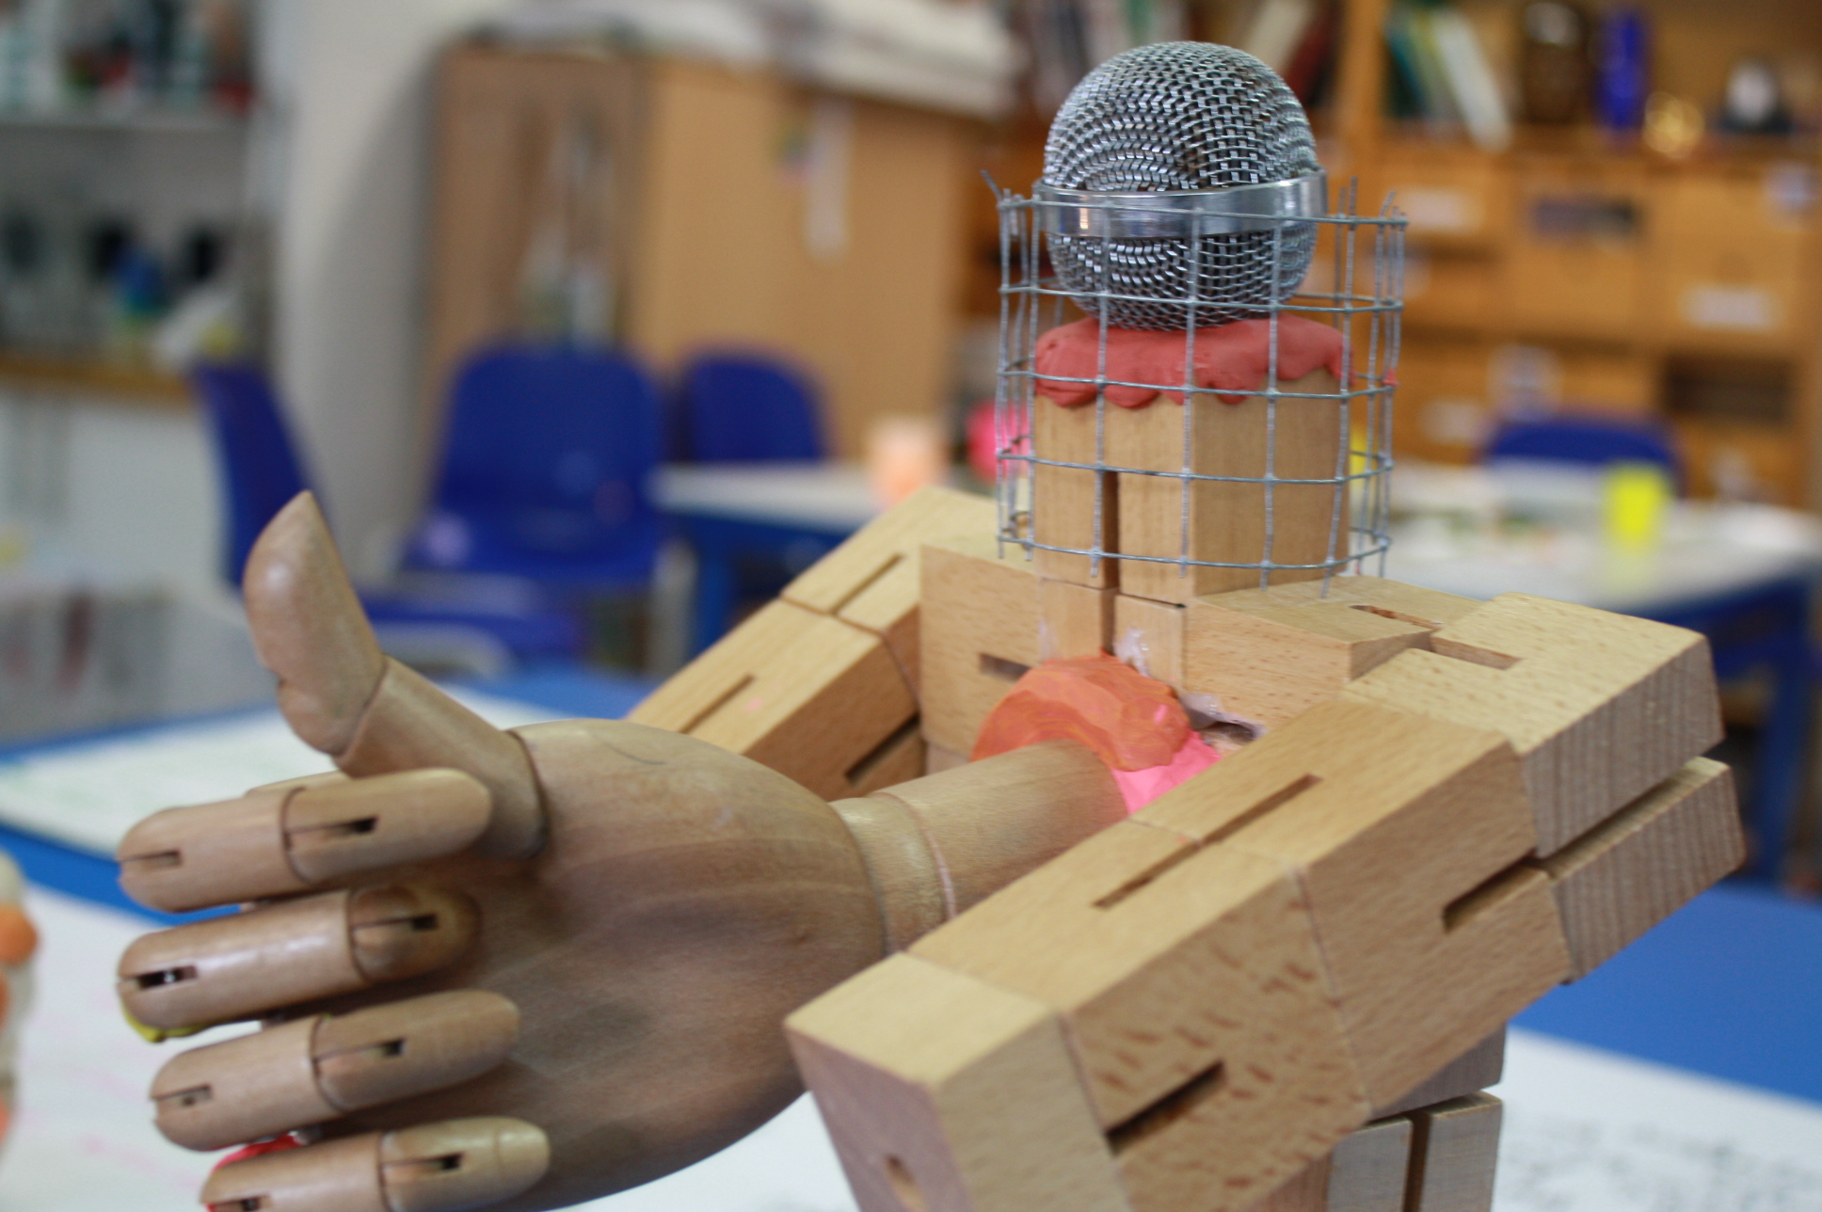
The young people were working across 3 languages and had the challenge of creating a trilingual script. They worked together across their languages to create the trilingual script and bring it to life using different accents and voices. The Art teacher reflected on the moment the students started to animate their characters and experiment with voice that there was a ‘wind of energy and fun’.
The students had to create their robots, their voices and stories, but also go outside to find locations for their digital story (Macleroy, 2019: p. 210)
1. Create a back story for the characters in your digital story.
2. Seek out different locations or create film sets for your digital story.
Pre-Production: Creating character back stories

