Slide 1
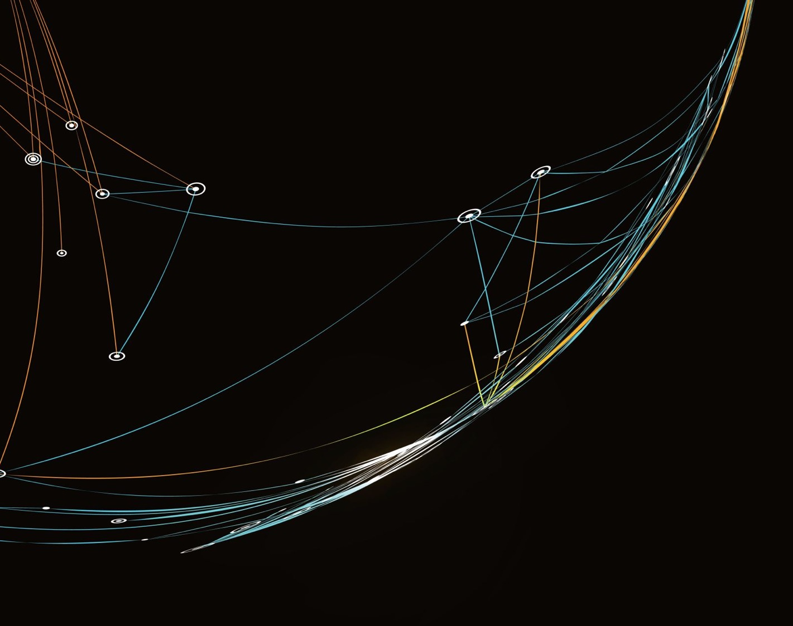

Critical Connections:
Multilingual Digital Storytelling Project
Professor Vicky Macleroy, Dr Jim Anderson, Dr Yu-Chiao Chung, Dr Judith Rifeserr
Workshop 6: Post-Production (editing and subtitling)

Slide 2
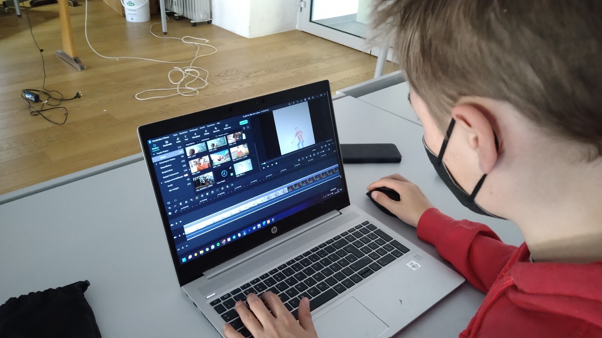
@Herz-Jesu Institut Mühlbach, Italy.

Slide 3
Post-Production: Editing Suite
Consider for a 3 – 5 minute film:
Scenes to keep
Scenes to cut
Shot order - sequence
Adjust clip length
Length of film
Sound: voice(s), voice-over etc.
Sound: music
Special effects
Subtitles
Titles and credits
Ensure that the music you choose does not infringe any copyright laws.
Royalty Free Music:
https://www.bensound.com/

Slide 4
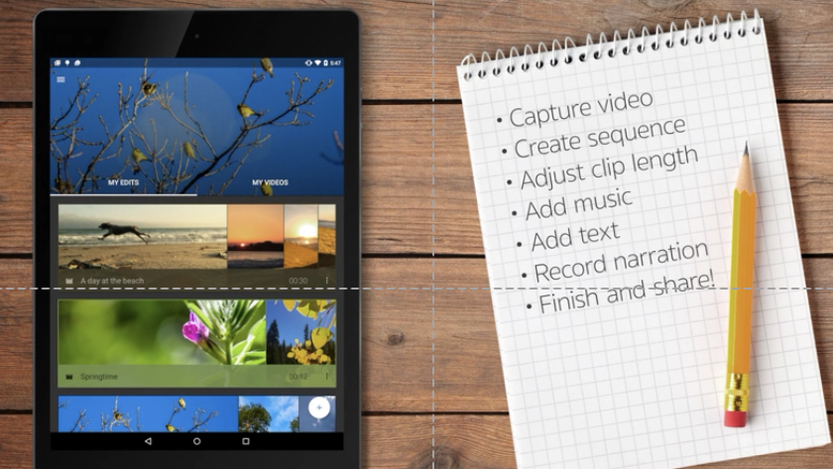
WeVideo – Android (or IMovie for Mac Users)

Slide 5
Post-Production: Using Windows 10 Video Editor
Open Windows 10 Video Editor on your computer.
Start a new video project.
Click on your new video project and name it.
In your video project library click on add media to get started (add videos, photographs and pictures from your memory stick).
Go to storyline and click on add a title card.
Right click and edit title card. Remember to press ‘Done’ after each step. You can also preview.
Drag video footage from the project library down to the storyline for editing.
Edit video footage on the storyline – trim video and/or split video.
Drag a photograph/picture from the project library down to the storyline for editing.
Edit the photograph on the storyline – duration and/or resize.
Continued on next slide …

Slide 6
Using Windows 10 Video Editor - continued
· ·
Add subtitles to individual clips on the storyline.
Add other effects to clips on the storyline – filters and/or motion.
Add music to clips – background music from Video Editor.
Add voiceover/own music – select from folder on memory stick.
Add 3D effects – move effects around the image.
Finish film – save as High 1080p video quality
Export your film
Save your film with film title on your memory stick.
Use this Video Editor Tutorial for additional support: https://youtu.be/edKDxJ7C8HE

Slide 7

Post-Production: IMov for iPad
· Create a Movie Project
Import video clips and photos
Arrange video clips and photos on the timeline
Trim a video clip or photo (change duration on the screen, remove unwanted sections)
Remove a clip / photo from the project
Adjust the movement of photos (zoom in / out) and speed of video clips
Apply filters – cinematic touch (black &white, change colour)
Insert and arrange audio clips
Record voiceover directly into the project
Add music and sound effects
Adjust audio (volume)
Add subtitles/translation and credits
Upload your film into a shared folder

Slide 8
Post-Production: Subtitling
Discuss:
What are subtitles?
Have you ever watched a film with subtitles?
Why are they useful?
Here you can find out more about how to do subtitles well to create a more inclusive film. There are a few different exercises that will help you understand more about the art of subtitling.

Slide 9
Post-Production: Subtitling
Elfi Troi (Herz-Jesu Institut, Italy) comments that translating and subtitling is a quite challenging job to do. In her experience it is not her students’ most favourite part of the filmmaking process. They even try to avoid subtitles and therefore choose English as their main language which is a pity because the other languages don’t get a chance to be involved.
In my view, it is really important to think about the text included in the film beforehand (storyboard) and to bear in mind that the subtitles need to follow certain rules to make the film accessible. In my pupils’ feedback on the films they watched, they often mentioned that subtitles in the films were too small, too fast and sometimes even annoying.

Slide 10
Post-Production: Subtitling
You could develop a subtitling activity similar to the example created at the Croatian Supplementary School, UK.
Subtitling activity:
We will continue to develop our editing skills. We will use a short instructional video – how to make a porridge – and add narration and subtitles. Timing has to be perfect!
See Workshop 6 Progress Map Resource (step 9).

Slide 11
Post-Production: Voice-over and/or music
How students develop music skills in filmmaking:
participants identified how music can be used descriptively to represent different animal characteristics as well as different situations in the story.
they explored and explained their own ideas and feelings about music using movement, body sounds and small percussion instruments.
Through signing games (building process) they became familiar with musical characteristics such as pulse and rhythmical patterns.
They became familiar with the musical term leitmotif and with its function in music.
This analysis was composed by Chryso Charalambous (theatre educator) with the collaboration of Maria Yerosimou (music educator)
(Critical Connections Handbook for Teachers, p. 75)

Slide 12
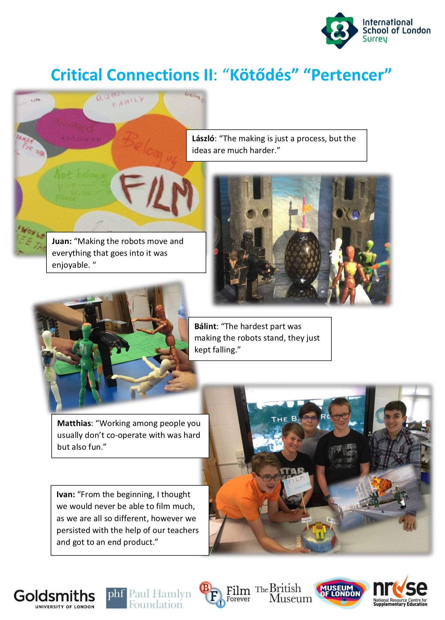
Post-Production: Peer review and group reflections
Peer review and assessment is a key part of the creative process in developing successful multilingual digital stories. During the project, students develop their own assessment criteria which makes assessment more transparent for students and more memorable. This process helps students to build critical judgment and take on board the critique of others.
Students document the filmmaking process through photographs; interviews and quotes; and creating posters to share their ideas with other project schools.
See ISL poster as an example.

Slide 13
Post-Production: Troubleshooting
‘When I started making the film, I thought it was going to be easy by putting a bunch of pictures together, however, I had multiple challenges while making this film such as finding the right music and fitting the film in the time frame with just pictures. However, my biggest challenge was recording my voice. This was when I needed some help because there were some words I didn’t know the translation to and whether or not they made sense … I also managed to improve my Croatian and become more confident in speaking.’
Student, Croatian Supplementary School, UK

Slide 14
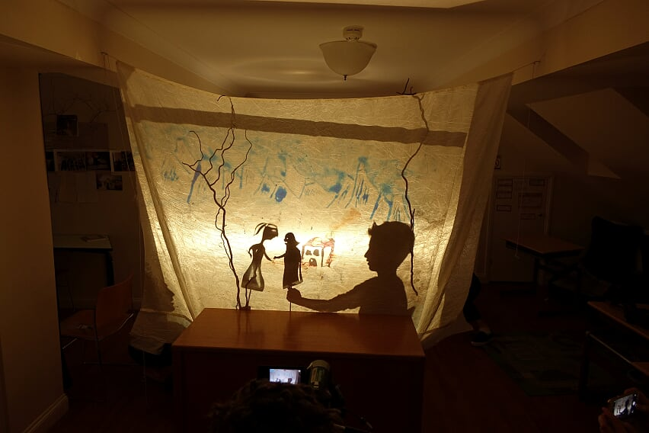
Post-Production: Documenting the filmmaking process (1)
The Making of Stribor’s Forest
This Croatian-English shadow puppet film tells a story about a young man who goes to Stribor’s Forest to chop some wood, where he mysteriously meets a snake who suddenly turns into a beautiful girl. He takes her home to meet his mother. From that day the mother’s life becomes unfair, and lives change.
https://vimeo.com/189141902

Slide 15
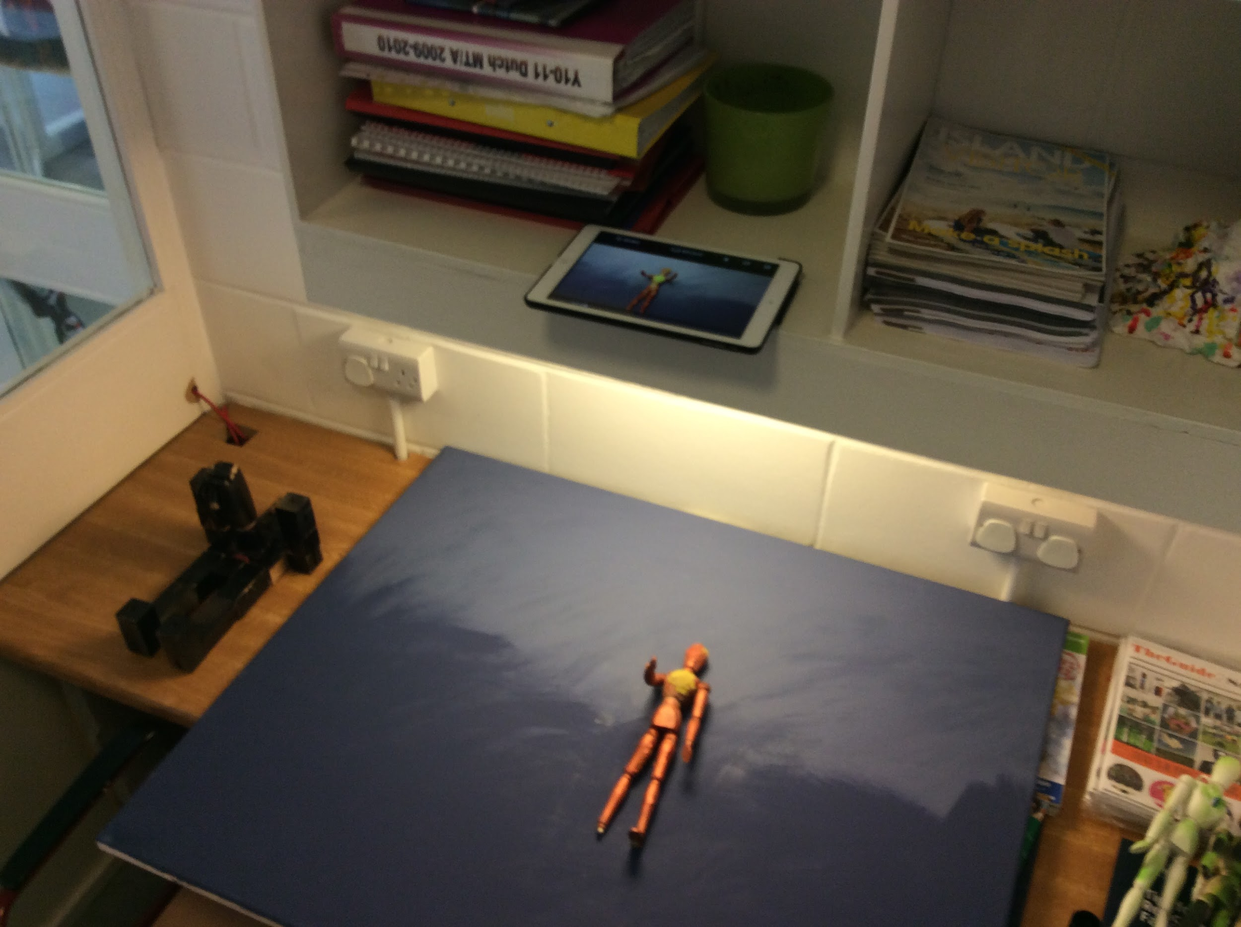
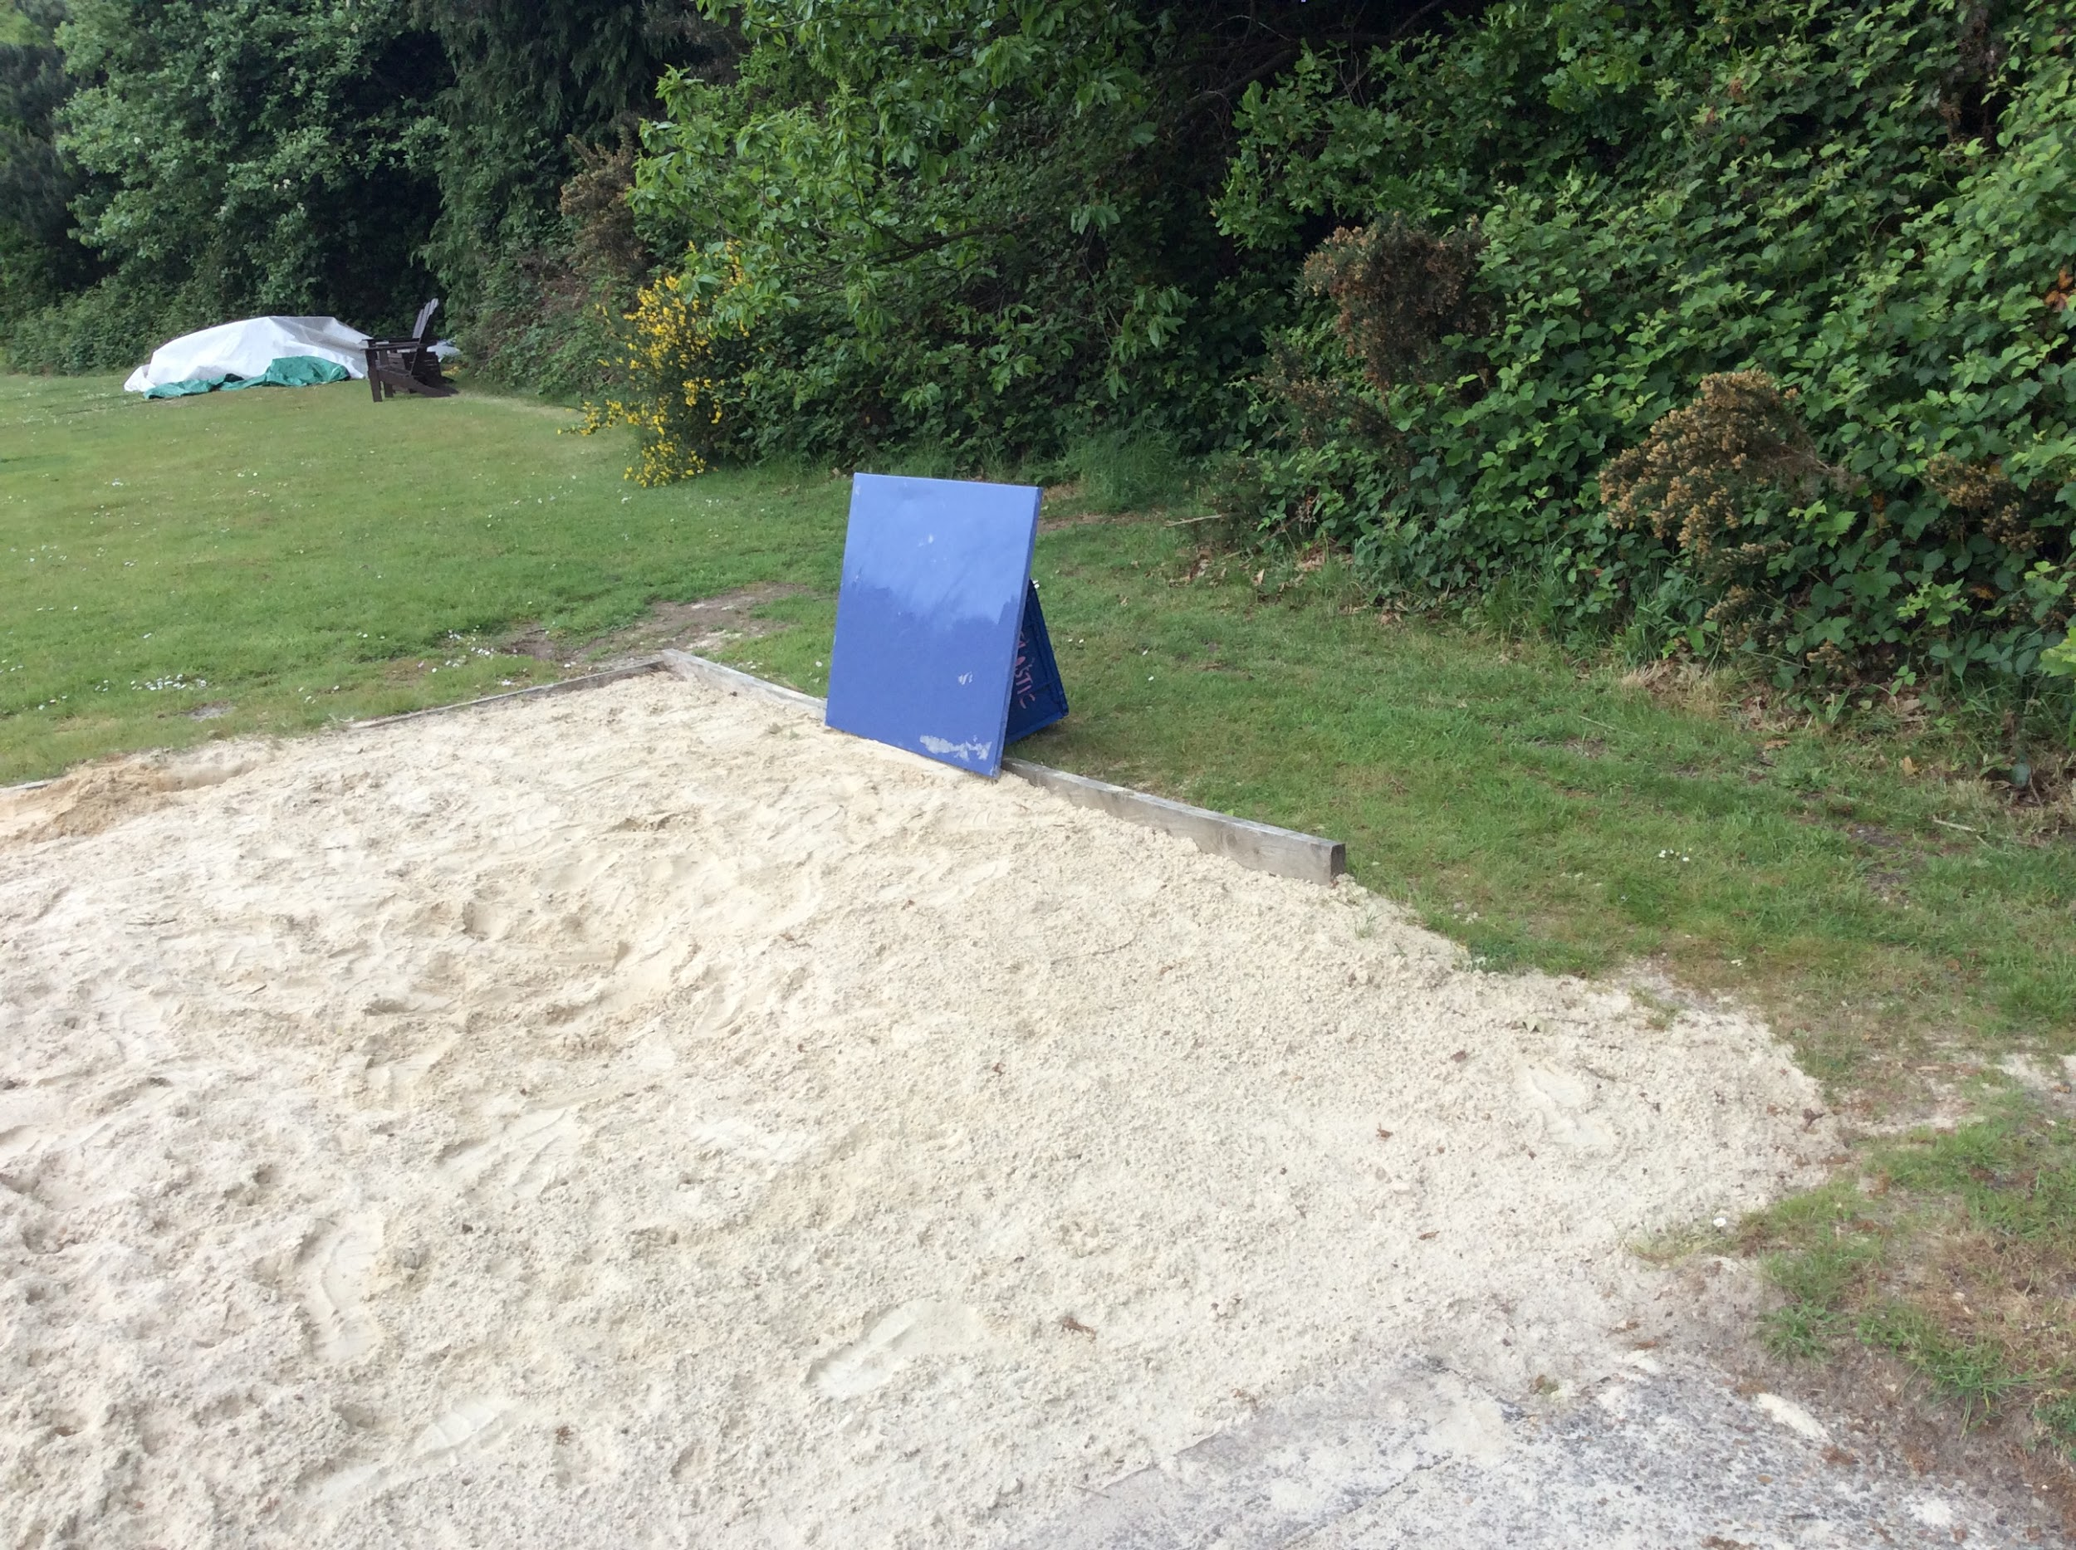
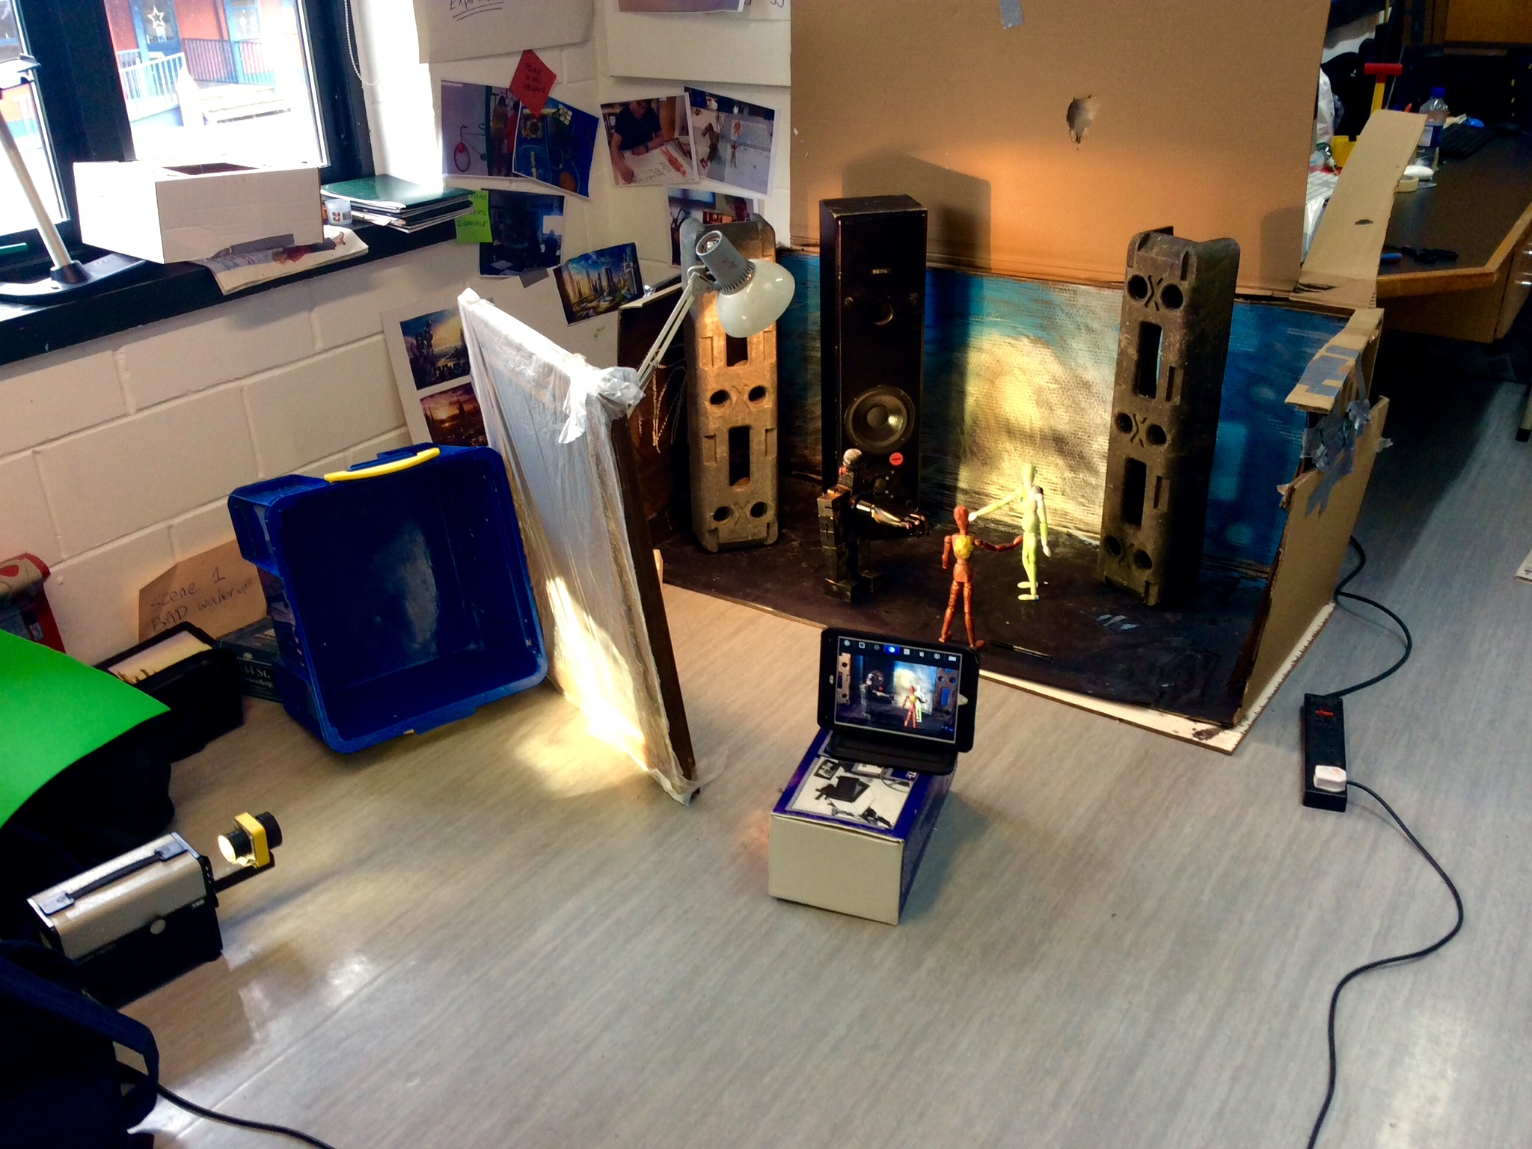
Post-Production: Documenting the filmmaking process (2)
Making of The B.A.D. Robot Film
B.A.D. Reflections
A documentation of the film making process of ‘B.A.D. Robot’ trilingual Portuguese, Hungarian & English film from the Goldsmiths digital storytelling project with some reflections.
Teachers: Marc Smith (Art Teacher) & Mirela Dumic (Languages Teacher)
https://www.youtube.com/watch?v=UmGyi_TDaR4

