Slide 1
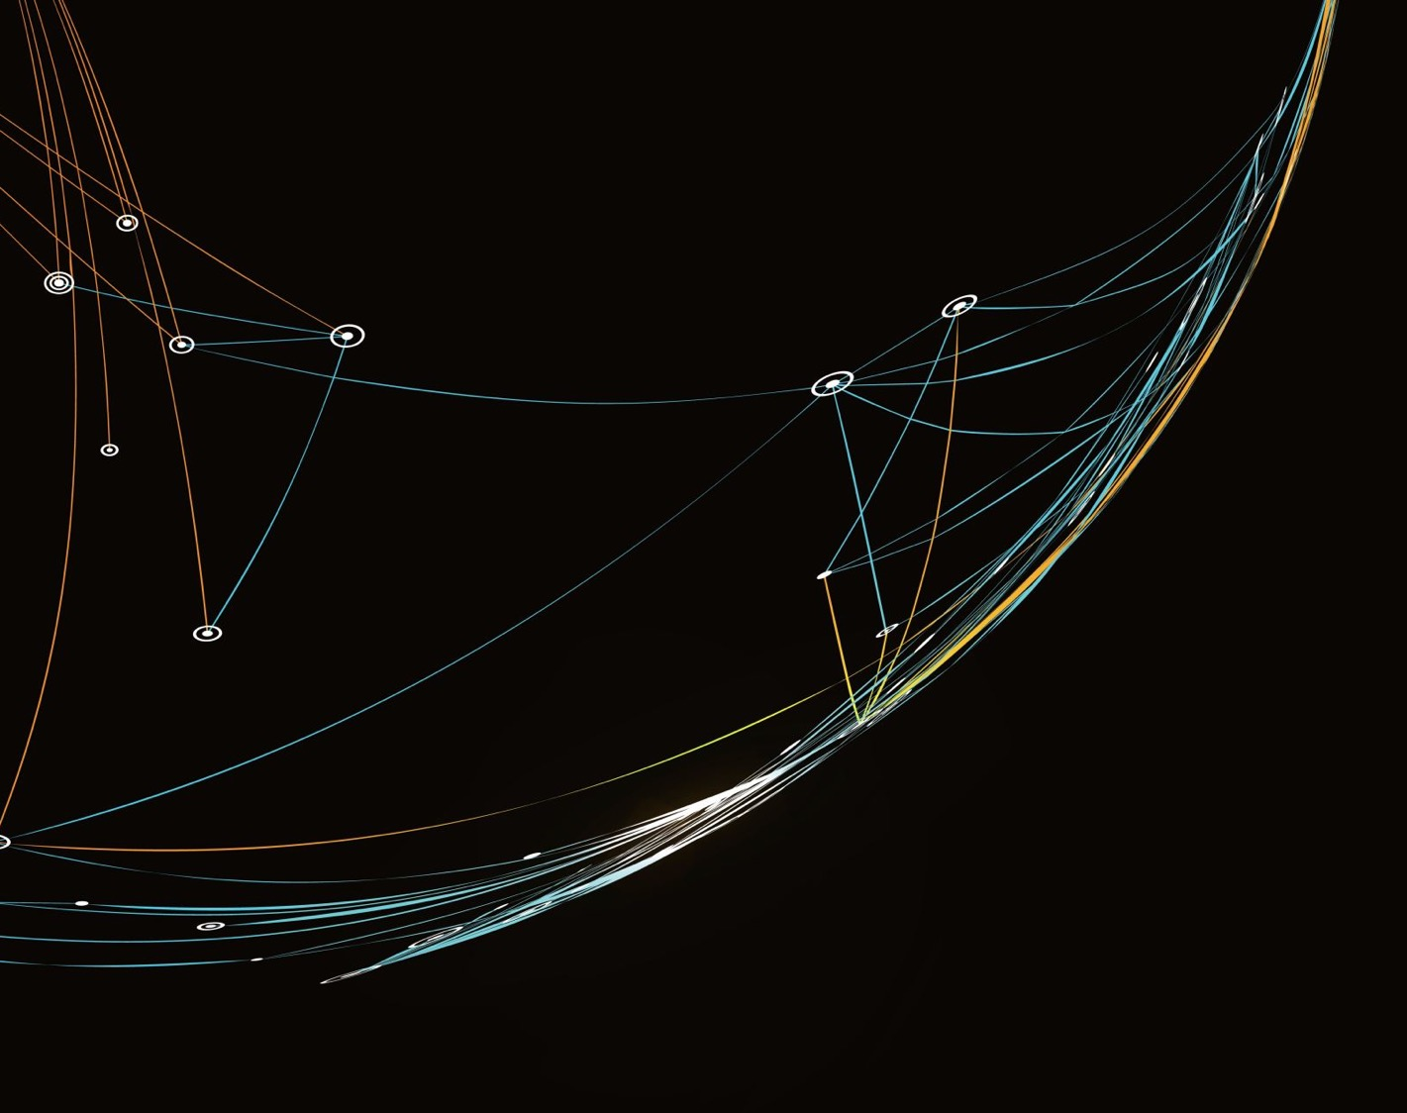

Critical Connections:
Multilingual Digital Storytelling Project
Professor Vicky Macleroy, Dr Jim Anderson, Dr Yu-Chiao Chung, Dr Judith Rifeserr
Workshop 7: Film Festival

Slide 2
Film Festival: Presenting to a public audience
… I was trying to count all the things that you’re showing that you can do and there’s really a lot, working together as a group, everybody who came up here talked about how they’d worked together as a group, and it is learning another language …
… And the other skill of course you’ve showed today is actually the digital film-making. It’s a wonderful thing, but the cleverness is to bring it all together – so you’ve had to work with other people, you’ve had to make the film and learn all those skills and you’ve had to begin to learn a language. And if you put on top of that working with schools from overseas, I just think it’s been a wonderful show of what you’ve been able to do.
Baroness Estelle Morris, Critical Connections Film Festival, Goldsmiths
https://goldsmithsmdst.com/film-festival-2013/

Slide 3
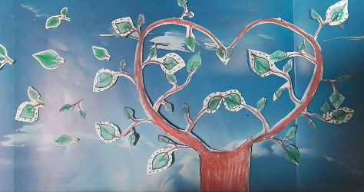
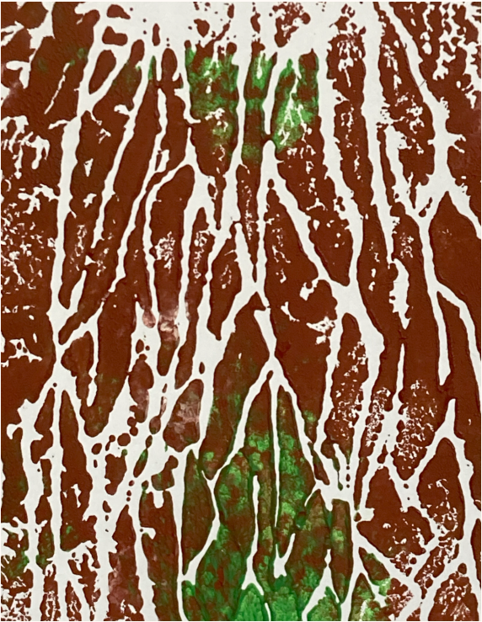
Film Festival: Film Booklet and Film Screening
Have look at the Film Booklet and Film Screening 2023 to gain insight into how the films are presented to a global audience.
The images for the front and back cover of the film booklet are selected from students’ artwork. The images for the film booklet (2023) were created by students at the Herz Jesu Institut, Italy and Europa School, UK.
https://goldsmithsmdst.com/film-booklet-and-film-screening-2023/

Slide 4
Film Festival: Critical Connections Project
Check list for submission
MP4 film file – the digital story (3 – 5 minutes)
MP4 film file – introduction to the film – (about 1 minute). This could be a PowerPoint presentation about the film.
Title of the digital story
Photograph or screen shot for the film booklet
Lead teacher(s)
Year group and/or names of students
Languages in the film
Description of the film (50 – 100 words)
Name of school
School Logo (if you have one for the festival certificates
)
Fil

Slide 5
Film Festival: Creating a 1-Minute Introduction
What makes a good film introduction? Watch these 1-minute video introductions that students created for the ‘Our Planet Festival 2023’.
Introduction to Film 2 - Wurzeln Radici Roots, Italy:
https://vimeo.com/855412602
Introduction to Film 27 - The Food We Leave Behind, Taiwan:
https://vimeo.com/855406663
You can also look at the PowerPoint Presentation for the introduction to Film 17 - A Conglomerate of Emotions, India.
See Workshop 7 Resource Film Introduction.

Slide 6
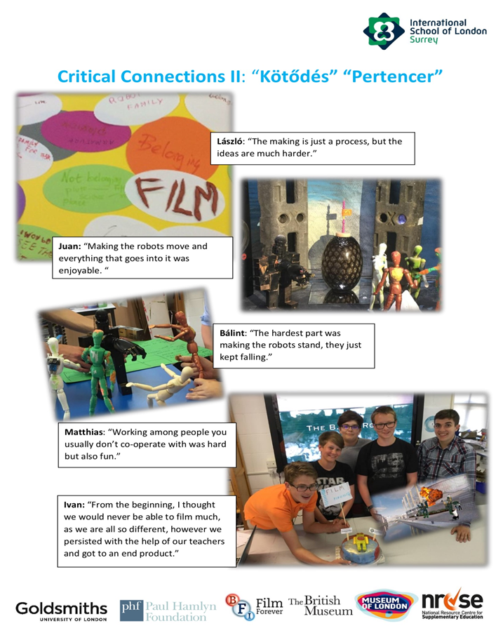
Film Festival: Creating a Poster
Students create film posters to present their films for the film festival.
Posters can include some of the following:
Photographs
Artwork
Filmmakers
Title of the film
Quotes from the filmmakers
Quotes from the film
Reflections
See ISL poster example but remember to include languages beyond English.

Slide 7
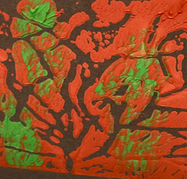
Film Festival: Reflecting on films from the festival
1. Which film apart from your own did you think was best and why?
2. What particular part in one of the films did you like? Explain your reasons.
3. What did you like most about your own film?
4. What did you learn through listening to different languages and watching films made in different countries?
5. How do you think you could improve your filmmaking in the future?

Slide 8
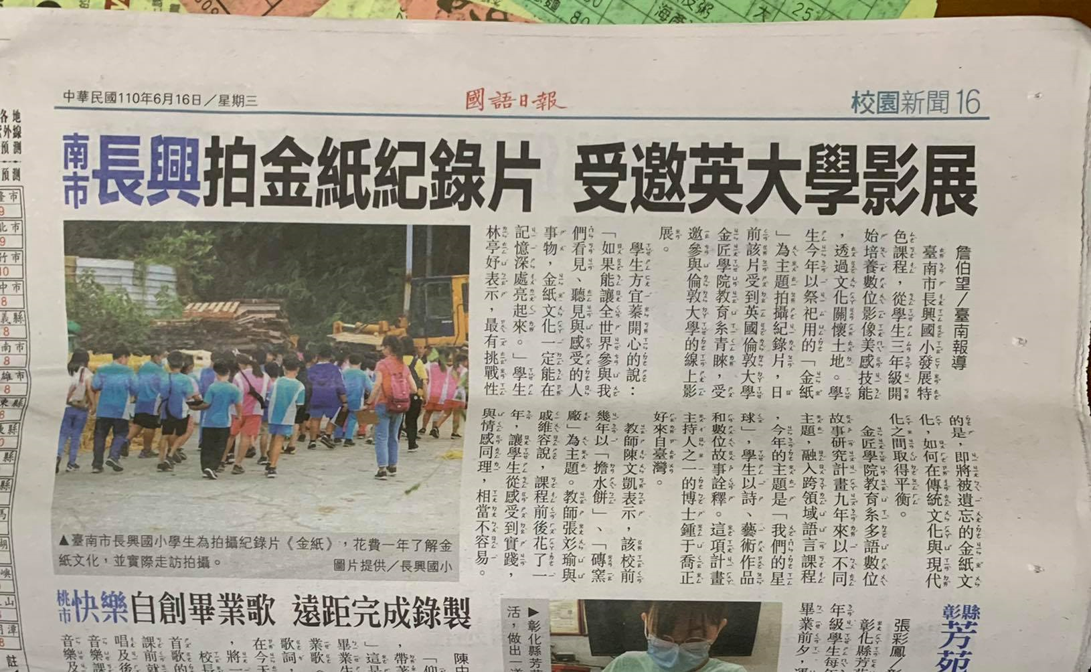
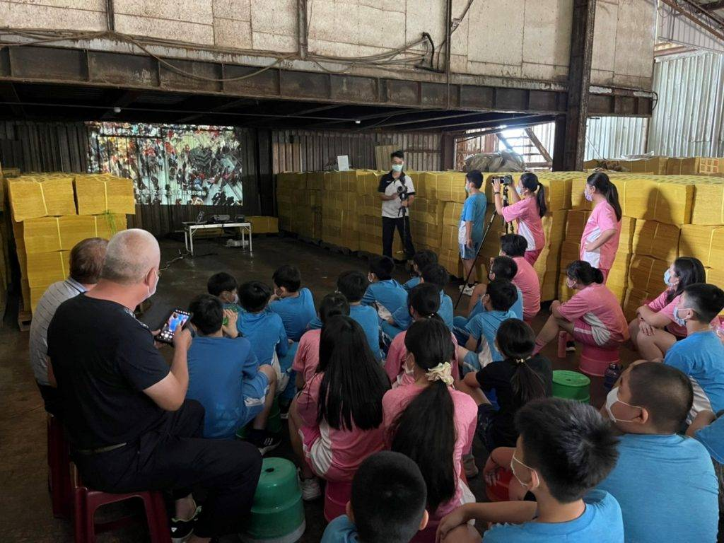
Film Festival: Presenting in local and global contexts
Smart Burners of Joss Paper - Changsing Elementary School (CES), Taiwan
https://vimeo.com/594635100
‘It is wonderful that our film will be watched by people around the world. Our global audience would be able to participate what we have seen, heard and felt. Then the traditional Joss paper culture wouldn’t be forgotten’ (Student, CES).
‘This has been an amazing and challenging journey. I have taught this course for several years. This project allows me to design this course from different perspectives, combining the global environmental issues happening in our local community. We started from local but then are able to present it to the world. The children are very motivated and excited and so am I’ (Lead Teacher, CES).

